Slide 1
Dissolved Oxygen
Module 6
River Watch

Slide 2
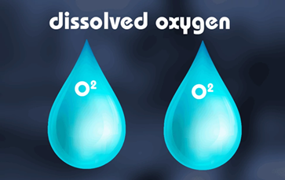
What is Dissolved Oxygen?
Dissolved oxygen (DO) is the amount of oxygen (O2) dissolved in the water, or the concentration of D.O. in the water.
DO does not include air bubbles. The oxygen must be dissolved in the water at a molecular level.
DO Saturation: the relative measure of oxygen concentration that is dissolved in water as a proportion of the maximum concentration that can be dissolved.
DO is measured as a percent of the maximum.
It is influenced by temperature and pressure.
How to Describe DO Levels:
Anaerobic: no oxygen present
Aerobic: oxygen present

Slide 3
What is Dissolved Oxygen?
Primary Productivity: the amount of DO available in the water
Takes both respiration and decomposition into account
Gross Productivity: the total amount of DO produced (via photosynthesis)
Net Productivity: the difference between the total amount of oxygen produced and the total amount of oxygen consumed

Slide 4
Why Monitor Dissolved Oxygen?
Reason 1: Most aquatic life breathes in D.O.
Oxygen is necessary for all living things’ survival and for many of the chemical processes that take place in water.
Necessary DO levels depend on the species varies with age, species, and activity of organisms.

Slide 5
Why Monitor Dissolved oxygen?
Reason 2: Oxygen levels can affect metals or other chemical changes through oxidation (loss of electrons during a reaction) or reduction (gain of electrons).
In anaerobic environments, chemical reactions can release organic and inorganic elements into the water.
Most rivers in Colorado are not anaerobic.

Slide 6
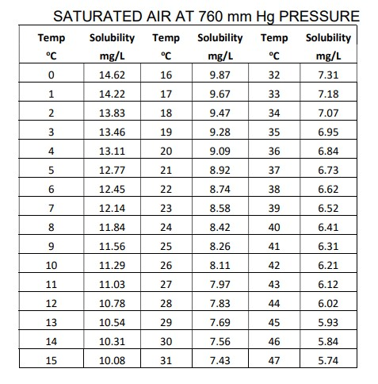
What Influences dissolved oxygen?
Temperature – cold water holds more oxygen than warm water
Elevation and atmospheric pressure – at higher elevations, water will hold less oxygen because there is less atmospheric pressure than at lower elevations
Velocity – faster water has higher oxygen levels than still water

Slide 7
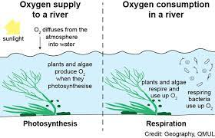
Main Influences of Dissolved oxygen: Elevation & Temperature
Elevation (altitude, air pressure) is the primary driver of dissolved oxygen levels.
Temperature is the other main influence.
Diffusion - The movement of molecules from an area of higher concentration to an area of lower concentration until dynamic equilibrium is reached.
Oxygen enters water by the process of diffusion.
Therefore, if there is “X” amount of OXYGEN in the atmosphere at a given elevation, there will be “X” amount of oxygen in the aquatic ecosystem. This will set the BASELINE for determining the optimal percent saturation for that ecosystem at that elevation.
The higher the elevation, the lower the amount of oxygen available in the atmosphere.

Slide 8
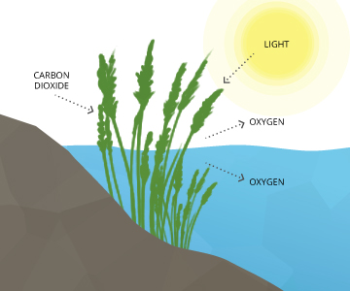
Other Influences of Dissolved oxygen
Biological activity
Organic wastes from wastewater treatment, industry, and runoff can decrease oxygen concentration.
Respiration/Decomposition - Bacteria consume O2 while decomposing organic material. Aquatic plants and animals respire (breathe) oxygen, which can reduce DO. levels.
Photosynthesis – Aquatic plants produce oxygen through photosynthesis throughout the day.

Slide 9
Expected Fluctuations in Dissolved oxygen
Daily – The sun affects water temperature and biological activity, especially photosynthesis and respiration rates.
Seasonally – Temperature varies seasonally.
Water management regimes, such as irrigation diversions or return flows, can also change temperatures. More sedimentation increases temperature.
River Continuum – DO decreases downstream due to lower elevations, lower gradients, slower velocities, larger volumes of water, warmer temperatures, and/or increased biological activities.

Slide 10
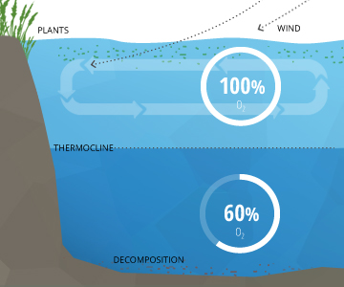
Expected Fluctuations: Rivers vs. Lakes/Reservoirs vs. Groundwater
Rivers – Rivers typically have higher concentrations of DO because its gradient is greater. Parts of rivers can be anaerobic (no oxygen) where there is a slow gradient (e.g. in backwater or near the bottom of large rivers).
Lakes and Reservoirs – Stratifies DO levels (oxygen levels will vary from top to bottom)
Groundwater – DO concentrations will vary with source, retention time and other variables.

Slide 11
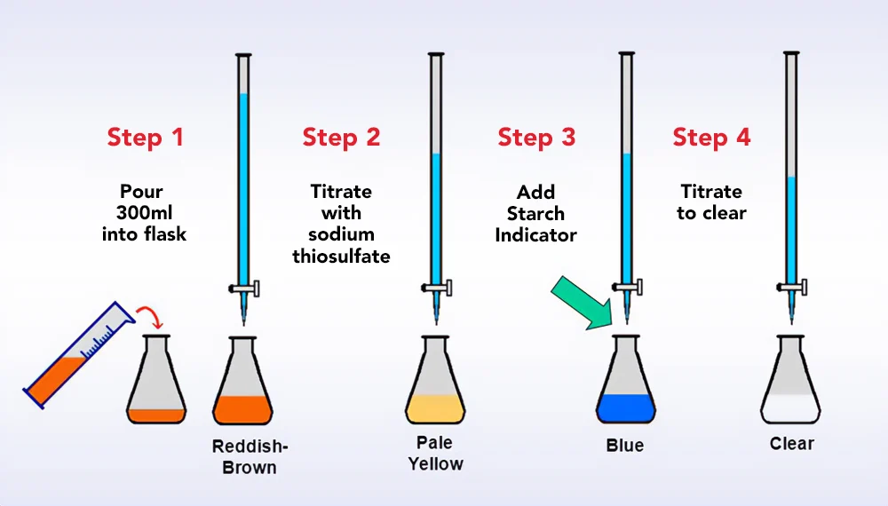
How is dissolved oxygen Measured?
The Winkler Method
Indirectly measures DO by taking advantage of how iodine reacts with an acid and by using a starch indicator to more precisely and consistently see the color change.
It is more precise than other test kits because it uses a Class A measuring devise, a starch indicator, and 300 mL of sample.

Slide 12
Winkler Method: The Chemical Reactions
Basic Explanations:
Manganese sulfate (MnSO₄) is added to the water sample, which produces manganese dioxide
Sulfamic acid (H+) is added and manganese dioxide reacts with iodide to form iodine
Iodide ions (I⁻) are oxidized to form iodine
The iodine is titrated with sodium thiosulfate (Na₂S₂O₃)
Chemical reactions:
Mn²⁺ + O₂ + 2OH⁻ → MnO₂ + H₂O
MnO₂ + 2I⁻ + 4H⁺ → Mn²⁺ + I₂+ 2H₂O
I₂ + I⁻ → I₃⁻
2S₂O₃²⁻ + I₃⁻ → S₄O₆²⁻ + 3I⁻
Simplified Reaction Equation:
I₂ + 2S₂O₃²⁻ → S₄O₆²⁻ + 2I⁻

Slide 13
Chemical Reactions Explained
Equation 1: In the presence of a base (OH⁻), dissolved oxygen reacts with manganous ion (Mn⁺²) to form manganese dioxide.
Flocculent forms in the BOD bottle at this stage.
Equation 2 + 3: When you add acid (H⁺ or sulfamic acid) the manganese dioxide will react with iodide to form iodine.
The solution turns yellow.
The amount of iodine formed is exactly twice the amount of dissolved oxygen originally present in the water.
Equation 4: If you know the amount of iodine, you can determine the amount of DO originally present. The amount of iodine can be determined by titration with sodium thiosulfate (NaS₂O₃).
Starch indicator is used as the final indicator to assist in making the endpoint more consistent and easier to see.
Starch turns blue if iodine is present, but it turns colorless after all the iodine has reacted with the sodium thiosulfate.

Slide 14
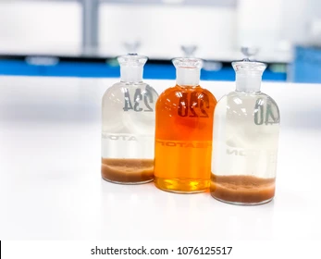
Data Collection: Dissolved Oxygen
Hold Time for Dissolved Oxygen: 8 Hours
Always take the temperature of the stream when you collect your dissolved oxygen sample.
There should NOT be any air bubbles in your sample.

