Slide 1
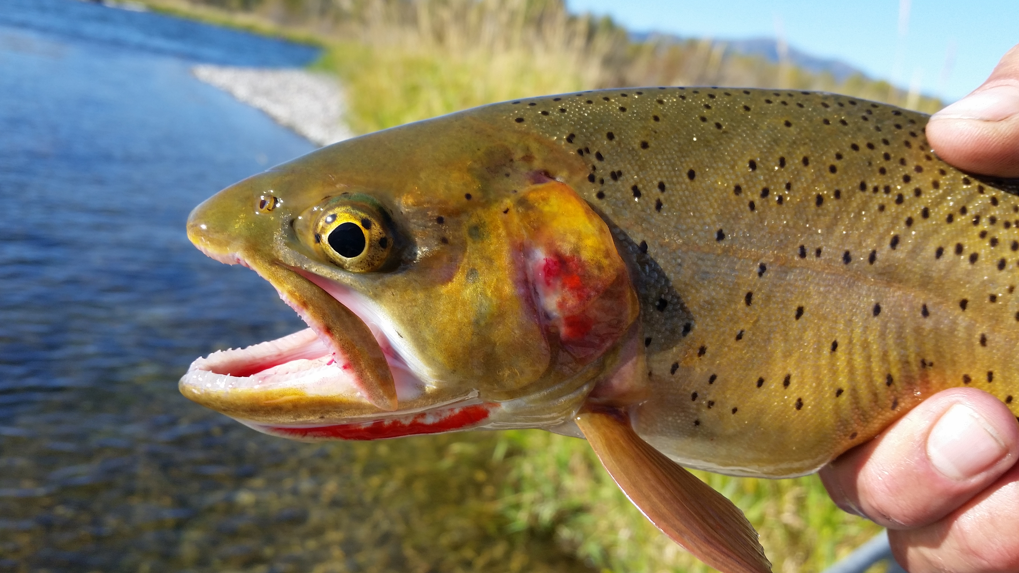
Module 14 Fish Management

Slide 2
Colorado Parks & Wildlife: Mission
To perpetuate the wildlife resources of the state
To provide a quality state parks system
To provide enjoyable and sustainable outdoor recreational opportunities that educate and inspire current and future generations to serve as active stewards of Colorado’s natural resources

Slide 3
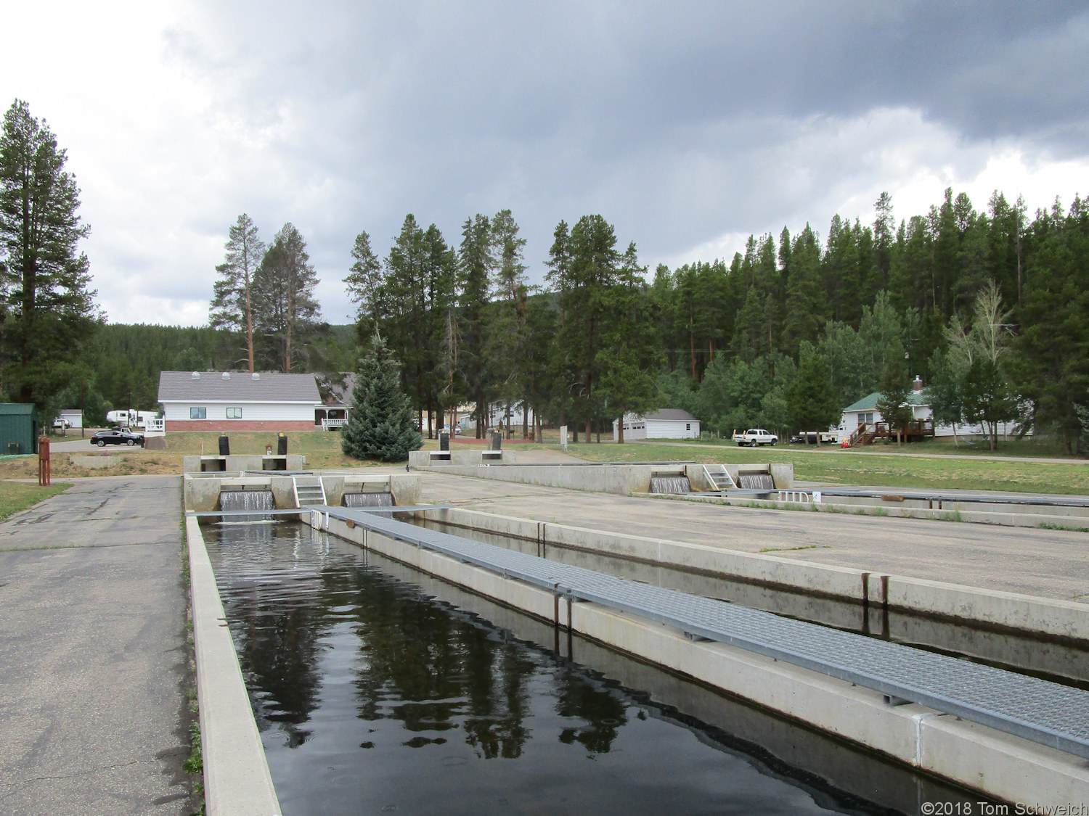
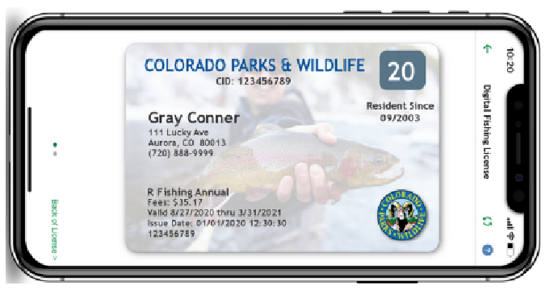
CPW Fish Conservation
Owners of wildlife areas and state parks
Angler recruitment and educational programs
Supervision and study from aquatic and conservation biologists
Hatcheries to increase fish stock
Licenses and regulations

Slide 4
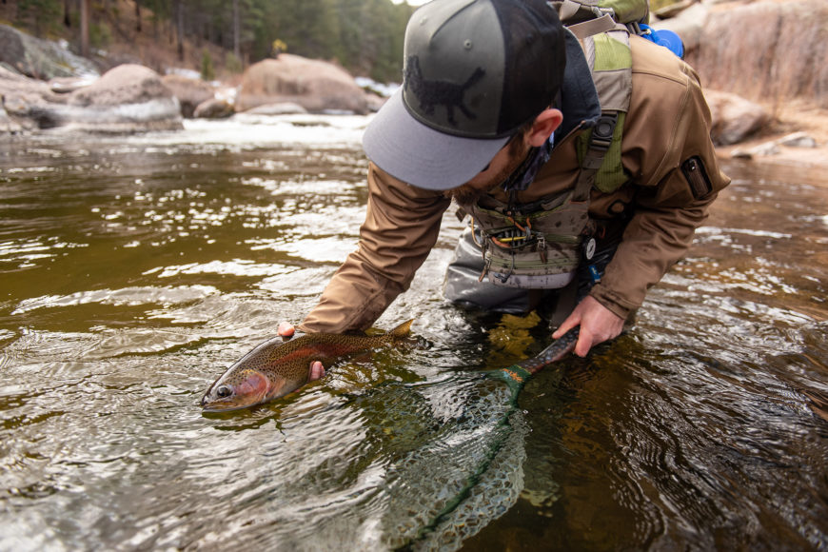
Management Goals
Preserve or restore native fisheries
Provide a variety of recreational experiences
Preserve outstanding fisheries (outstanding & gold medal waters)
Restore damaged fisheries
Mitigation
Notes:
-“Gold Medal” waters = fishery consistently produces a trout standing stock of 60+lbs per acre and produces an average of at least 12 “quality trout” (14+ inches) per acre.
-can only be applied to waters accessible for fishing by the general angling public
-must be a min of 2 miles in length (rivers) or 50 acres (lakes).

Slide 5
CPW Balancing Act
Environmental threats and conditions (climate, seasons, drought, floods, spills, etc.)
Competition for water management needs (supply for all uses, treatment, recreation, mitigation, etc.)
Conservation ( native, non-native, invasive) with the capacity of water

Slide 6
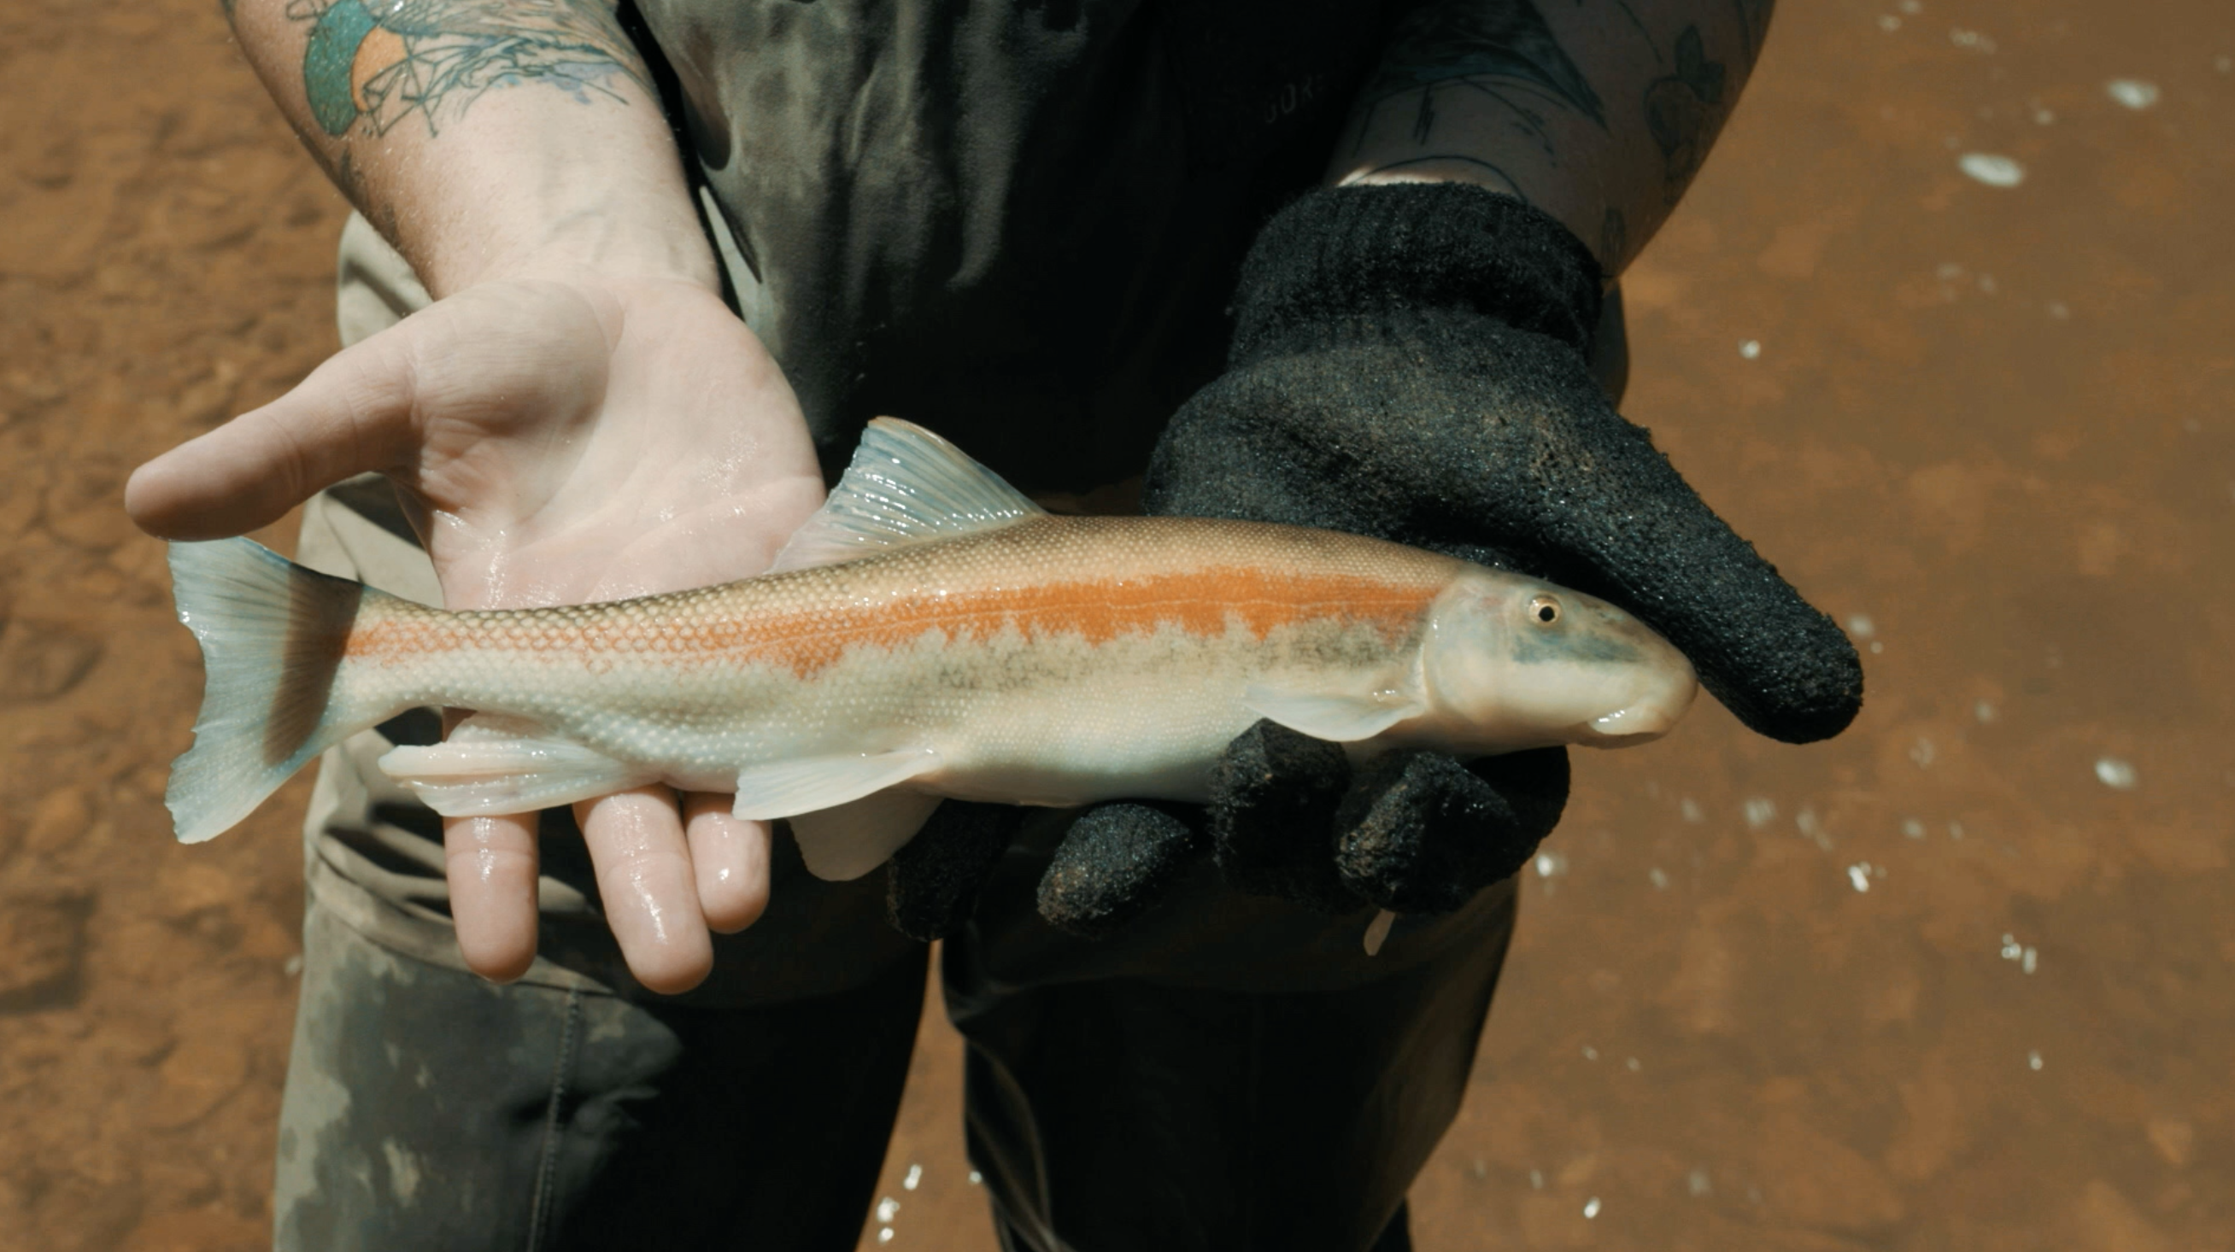
Native Fish
Also called indigenous or endemic
Occur naturally and are self sustaining (at least historically)
Fit into the natural food web and have a niche in the habitat
See how CPW is working to protect the native Flannelmouth Sucker, Bluehead Sucker and Roundtail Chub
Notes:
-Have evolved for our specific environment
-More likely to have resistance to pests and disease

Slide 7
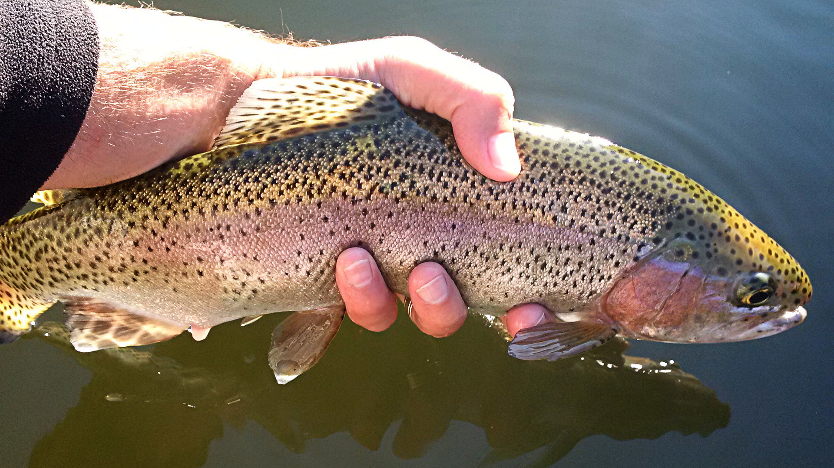
Non-native Fish
Also called exotic or alien Species
Did NOT originate in Colorado
Brought to Colorado by humans either on purpose or accidentally
Have no negative impact on the ecosystem
Examples include Brown, Rainbow, Brook Trout, Small and Large Mouth Bass

Slide 8
Invasive Fish
Non-native AND likely to cause harm to the economy, the environment, and/or human health
Examples include tamarisks and pikeminnow, and, in some areas, brown and rainbow trout
Notes:
Brown and rainbow are considered invasive when they live in areas w/cutthroat trout since they outcompete them

Slide 9
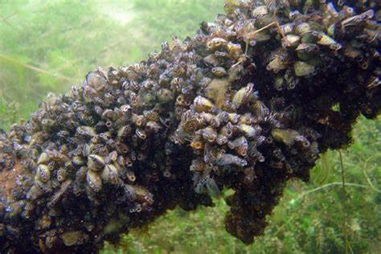
Aquatic Nuisance Species
Waterborne, non-native
Threatens:
Diversity or abundance of native species
Stability of a habitat
Commercial, agricultural, aqua cultural, or recreational activities
Pictured right: zebra mussels
Notes:
-Photo is of zebra mussles
readily attach to most hard submerged surfaces
affix themselves to shells of their own species and are able to form dense layered colonies of over one million per square meter.
-ANS have no natural controls, such as pathogens, parasites, and predators → exponential growth

Slide 10
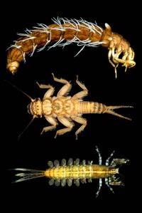
Indicator Species
Provide a signal of overall ecosystem health
Indicate if an ecosystem has suitable conditions for other species
Examples include mayfly, stonefly and or caddisfly in clean cold waters where trout are expected to reside
Notes:
-typically among the first species affected by any change in an ecosystem (pollution, climate change, changes in land use and other factors)
-used to guide policymakers for resource management plans
- 70% of indicator species are invertebrates: not very mobile/cannot as easily migrate to a healthier ecosystem.

Slide 11
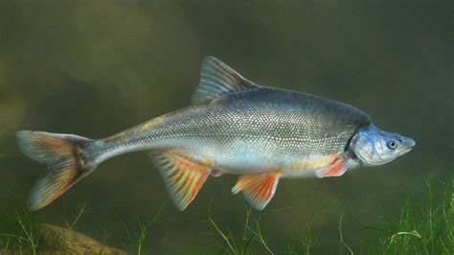
Special Concern Species
Vulnerable to environmental deterioration or habitat modification
At risk for becoming threatened, endangered, or extinct
SC designation informs land and water management, hunting and fishing regulations and conservation efforts
Notes:
-a species can become a SC if reproduction rates are low, they have a highly specialized habitat, or are rare
-Humpback chubs are an example (photo)

Slide 12
Threatened or Endangered Species
Severe risk for loss of a species in the wild
Based on its history, habitat requirements, threats
Threatened: likely to become endangered in the near future
Endangered: at risk of extinction through all or most of their geographic areas
These designations provide protection at state and federal levels
Species reintroduction programs designed to reverse conditions
Notes:
-Designated by US Fish and Wildlife Service
-Considers damage to its habitat, overuse of it, disease or predation, inadequate protection, and other factors.
-All the species listed as special concern are also considered T & E for Colorado

Slide 13
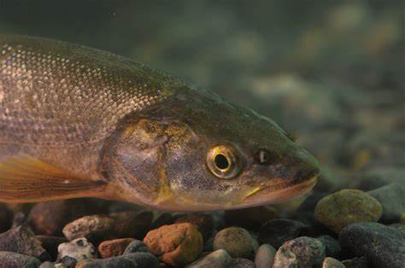
Extirpated Species
Extirpation (Local Extinction) – when a species is gone from part of its native range
Usually due to habitat loss or degradation
Not entirely extinct- at least one other population of the species still persists in other areas
Colorado Examples: pikeminnow (pictured left), humpback chub and razorback sucker

Slide 14
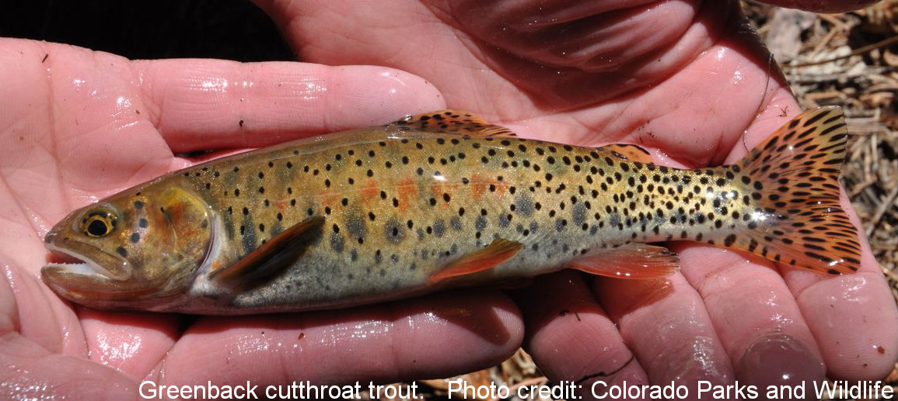
Extinct Species
Extinction – when no living members of a species remain anywhere on the planet
Caused by:
Environmental changes: habitat fragmentation, climate change, natural disaster, overexploitation by humans
Evolutionary changes: genetic inbreeding, poor reproduction, decline in population
Notes:
-CPW discovered previously thought to be 'extinct' greenback cutthroat trout reproducing naturally in Colorado waters (Herman Gulch)
-Listed as extinct in 1937, rediscovered in 2012
-Causes of “extinction”: pollution from mining, pressure from fishing and competition from other trout species

Slide 15
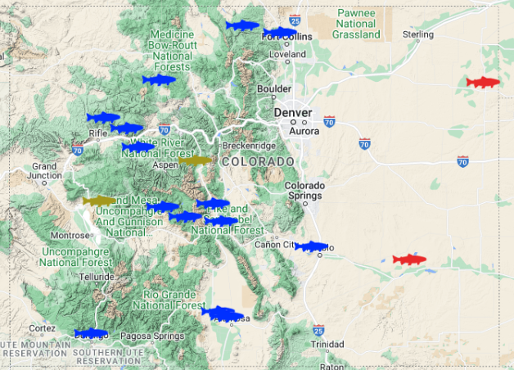
Fish Stocking
Not enough fish produced naturally to support anglers and natural habitats
Habitat loss/degradation
CPWs owns and operates 19 hatcheries
Breed, hatch, rear and stock over 90 million fish per year
Mostly cool water fish, but some warm water fish
Watch the video on CPW Fish Hatcheries
Notes:
-First hatchery established 1881
-Open to the public year-round
-Produces 2.4 billion dollars in revenue
-On map blue fish= Cold water facility, red fish= warm water facility, tan=USFWS hatchery

Slide 16
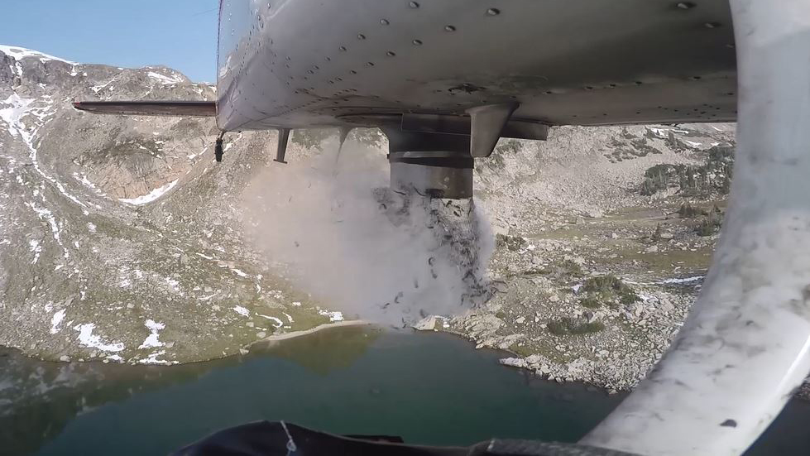
Fish Stocking (cont.)
Not all waterways in Colorado are stocked
Fish are stocked in areas where there is:
High fishing pressure (lots of anglers)
A natural decline in fish populations
A high loss of fish due to pests and disease
Stocking Colorado's Mountain Lakes by Plane

Slide 17
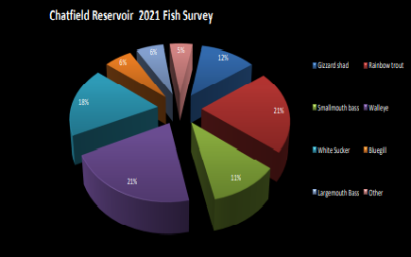
Population Censuses
CPW conducts hundreds of lakes and streams surveys each year to estimate wild fish populations
Provides guidance on how many fish to stock
Each waterway surveyed every ~1-10 years depending on size and priority
Determines abundance, density, and species composition
Notes:
-Specific fishery survey summaries here: Colorado Parks & Wildlife - Fishery Survey Summaries (state.co.us)
-Collected data is used to track fish population trends, evaluate the effectiveness of management actions such as stocking and regulations, and establish realistic management goals for a given lake or stream.

Slide 18
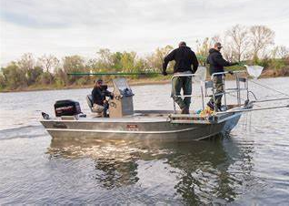
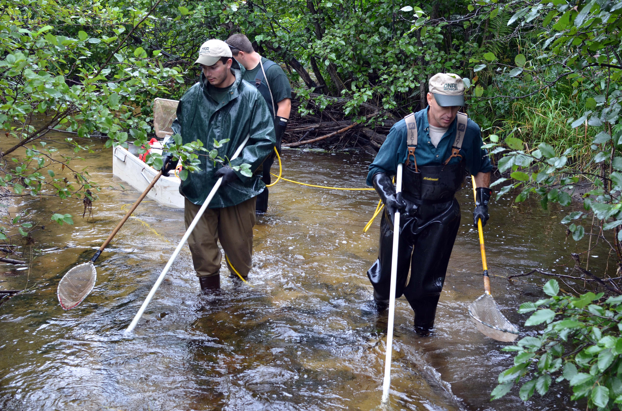
Electrofishing Methodology
Electricity temporarily stuns fish so they can be caught
Data is then recorded and fish are released
Uses 2 electrodes: one positive and one negative
Three primary types of electrofishers:
Boat mounted models: for larger reservoirs and rivers
Backpack models: remote locations and small streams
Shore mounted models: medium to large rivers
Notes:
-Boat electrofishing, the boat itself is the negative, and the positive electrodes are generally mounted off the bow
-Backpack electrofisher, the positive is located at the end of a long pole and is usually in the form of a ring. The negative is a long braided steel cable that trails behind the operator.

Slide 19
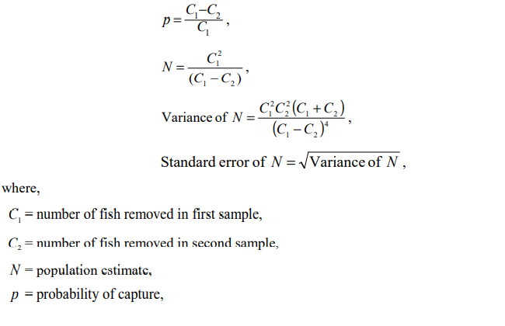
Population Estimates
Number and pounds of fish per acre
Seber and Le Cren two-pass population estimate:
Fish captured and removed during two sessions

Slide 20
Seber Le Cren Example
On the first pass 200 fish were collected and on the second pass 95 fish were collected. The population estimate is then between 321 and 441 fish.

Slide 21
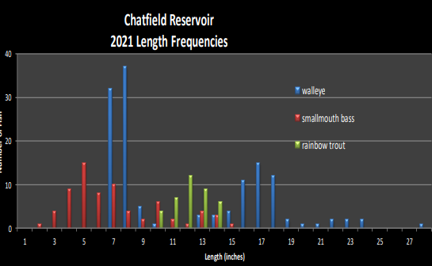
Length Frequency Distribution
Graph of the number of fish collected in each length category
Helpful for determining ages of fish in a population
Notes:
-Assumes fish length within each age group is normally distributed around a peak value
-Plot length (x axis) against # of fish (y axis)
-Used to estimate age
-Trout example:
Year old or less= 1-2 inches
1-2 years old= 4-7 inches
2-5 years old= 7-12 inches

Slide 22
Brown Trout
Fact Sheet
Appearance: light brown with silvery sides and black spots on back
Habitat: cold water habitats everywhere from high mountain streams to broad rivers flowing on the plains

Slide 23
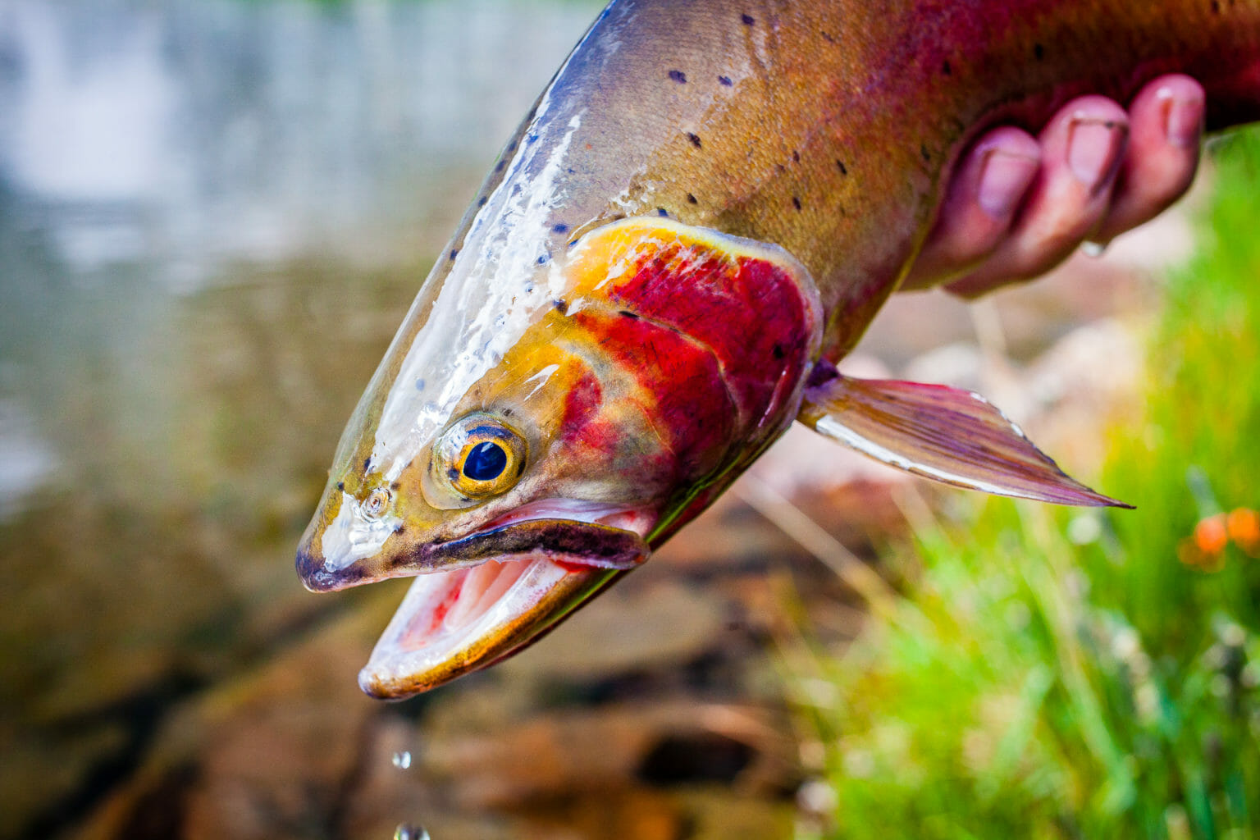
Cutthroat Trout
Fact Sheet
Appearance : red slash on their “throat,” heavy spotting near tail
Habitat: high cold mountain streams and lakes

Slide 24
Smallmouth Bass
Fact Sheet
Appearance: reddish eyes, broken vertical lines on sides, small jaw that does not extend beyond the eye
Habitat: stocked in both warm and cold lakes and reservoirs

Slide 25
Green Sunfish
Fact Sheet
Appearance: olive with yellow trim on fins, rounded pectoral fins, large mouth, panfish shape
Habitat: streams and impoundments

Slide 26
Colorado Pikeminnow
Fact Sheet
Appearance: torpedo-shaped, olive-green and gold back, silver sides, white belly
Habitat: swift flowing muddy rivers with quiet, warm backwaters

Slide 27
Brassy Minnow
Fact Sheet
Appearance: multiple lines fanning out from focus of the scale, dark dorsally with brassy sides and cream colored belly
Habitat: Eastern plains, slow moving water with lots of stream cover

Slide 28
White Sucker
Fact Sheet
Appearance: single dorsal fin, sucking mouth, long cylindrical body, coarse scales
Habitat: deep, slow moving water

Slide 29
Long Nose Dace
Fact Sheet
Appearance: olive green to brown on back, white on belly, mottled on sides
Habitat: swift moving, shallow waters with cobble bottoms

Slide 30
Fathead Minnow
Fact Sheet
Appearance: small mouth with rounded, blunt snout, first dorsal ray of dorsal fin is shorter and split away from remainder of fin
Habitat: can tolerate most environmental conditions

Slide 31
Fish Life Cycle
Notes:
Most Colorado fish
-Spawn in Oct/Nov
-Eggs incubate Dec-Mar
-Sac Fry phase Mar-May
-Fry emerge May-Jun

Slide 32
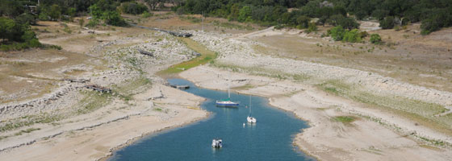
Water Flow and Fish Life Cycles
Reduced Flows:
Causes dewatering, which can be lethal for eggs during spawning and incubation
Excessive Flows:
Increases water velocity, which can be lethal for fry

Slide 33
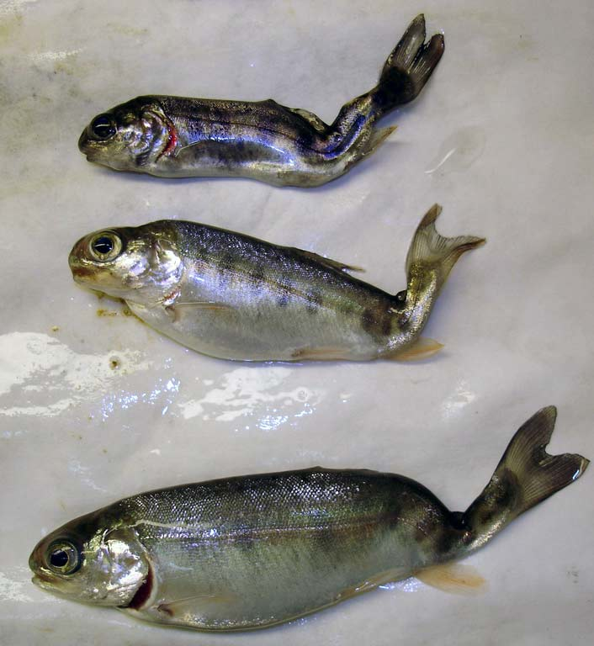
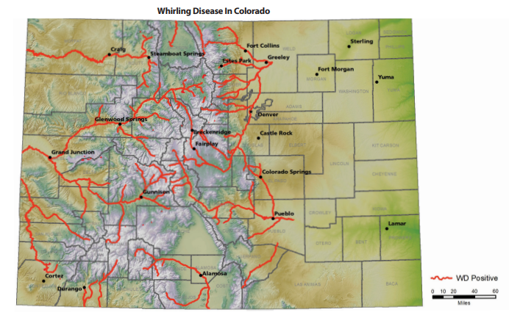
Whirling Disease
Infectious disease carried by trout and salmon
Caused by parasite Myxobolus cerebralis
Signs of this disease include a sunken head, bent back, and swimming or “whirling” in circles
Notes:
-90% mortality rate, those that do survive are deformed
-no treatments/cures

Slide 34
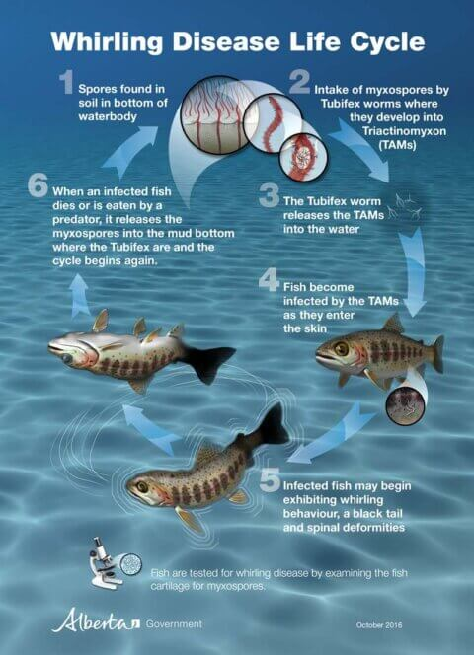
Whirling Disease (cont.)
Myxobolus cerebralis has a two-stage life cycle:
Spores from parasite are ingested by tubifex worms (intermediate host)
In the worm, spores transform into Triactinomyon (TAM)
Fish eat the worms OR the worms release TAMs into the water, to be taken up by fish
TAMs infest soft tissues in fish causing deformities
Notes:
Infest worm first- cannot directly infest fish
-Affects young fish more severely as they have softer neuro tissue
-Affects brook, cutthroat, and most significantly, rainbow trout

Slide 35
CPW Hatcheries and Whirling Disease
6 hatcheries considered positive for whirling disease (though risk is very low)
Cannot stock trout from hatcheries that test positive into waters where whirling disease has not been found
Recent research into whirling disease resistant rainbow trout
Notes:
-Rainbow trout from Europe (Hofer) have natural resistant to WD (which originated there).
-Crosses between the Hofer and Colorado River Rainbow trout strains are now reared by several state hatcheries and are stocked into rivers and streams where rainbow trout populations were severely impacted by whirling disease.

