Slide 1
Metals
Module 9 River Watch

Slide 2
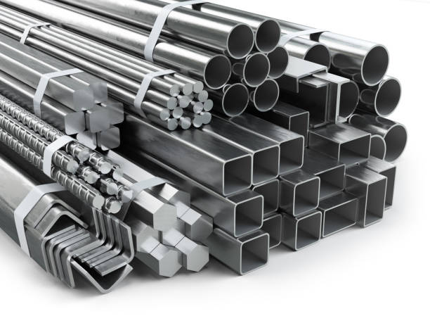
Where do metals come from?
Metals naturally occur in rocks, soil, and water all over the planet.
They are unevenly distributed throughout the Earth’s crust and surface primarily according to the geology of each area.
A biogeochemical cycle distributes metals between the Earth’s surface, living organisms, and the atmosphere.
Human activity has increased the rate of the redistribution of metals.
Sources of Elevated Levels of Metals:
Volcanic activity
Release of gasses or liquids from fractures in the Earth’s crust
Industrial processes (e.g. burning fossil fuels, producing chemicals or pesticides)
Mining
Erosion of rocks or minerals containing metals

Slide 3
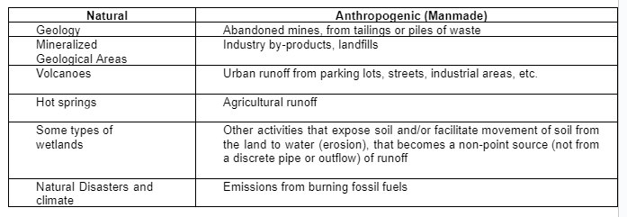
Influences on Metals Concentrations

Slide 4
Enhanced Metals Levels
Quantity of Metals
Depressed Metals Levels
Regional scale processes can increase the amount of metals in an area. High levels of metals can be toxic, or harmful, to living organisms.
If an area has lower levels of metals, living organisms can also suffer from a deficiency of the metals they need for biological processes.

Slide 5
Fluctuations in metals concentrations
Daily
Seasonal
Rivers vs. lakes vs. Groundwater
River Continuum
Metals concentrations do not significantly fluctuate daily, unless there are unnatural discharges of metals into the river.
In highly mineralized areas or places with a loading source for metals, run off from storms or snowmelt can increase or decrease/dilute metals concentrations.
Metals concentrations naturally remain at background levels. If there is human activity, metals could increase downstream.
There is no general pattern in metals concentrations across different bodies of water.

Slide 6
Filtered Sample
Filtered samples measure the amount of dissolved metals that have the ability to harm organisms.
Ionic/free/dissolved metals - a metal ion with an associated charge; considered to be a bioavailable, “single” form of metals that is consumed by living things and can attach to other elements
Only dissolved metals can pass through the filter into the sample.

Slide 7
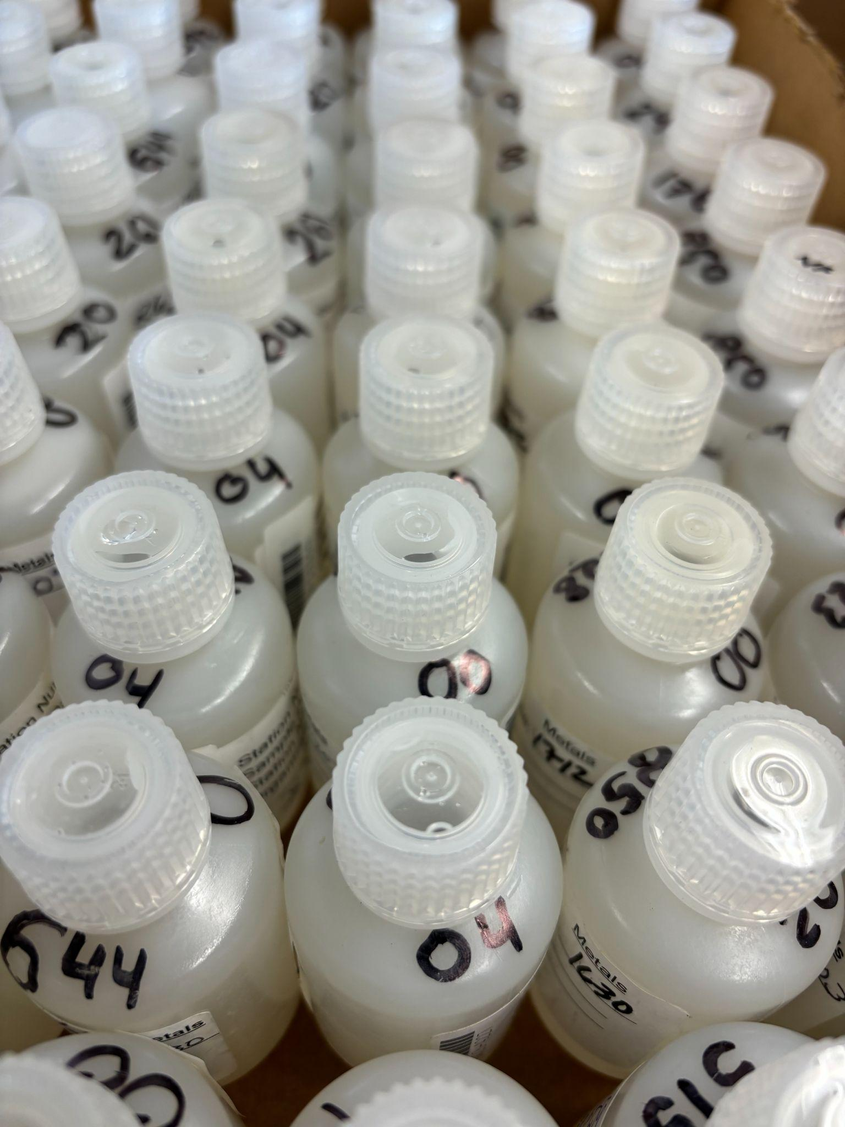
Non-Filtered Sample
Total (non-filtered) metals samples measure the total amount of metals in the water, including both the free and combined metals.
Combined metals - free metals attached to another element, forming a compound
This form of metals is not as harmful to aquatic life.

Slide 8
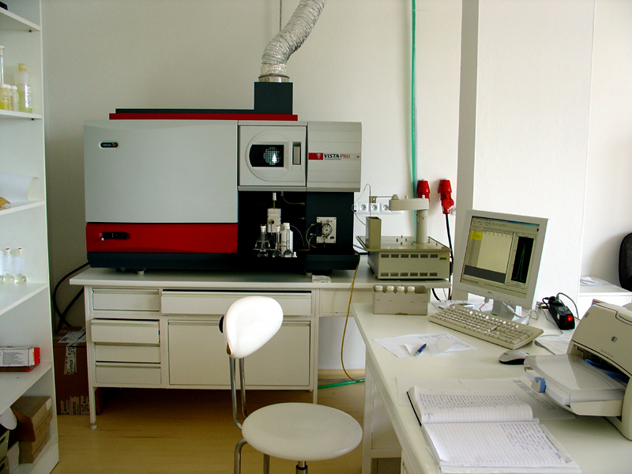
How RW measures Metals
Inductively Coupled Plasma Atomic Emission Spectrophotometer (ICP)
The River Watch lab uses an ICP machine to measure the amount of metals in each sample.
This machine can detect metals even when they are present at low levels, allowing River Watch to compare the results with any of the Clean Water Act’s standards.

Slide 9
Units of Measurement
Parts per Million (ppm)
Parts per Billion (PPB)
Mass in Volume
# of units of a pollutant (metal) per one million units of the solution (water)
# of units of a pollutant (metal) per one billion units of the solution
River Watch reports metals concentrations in ppb
Mass of the chemical in the total volume of water (mg/L or µg/L)
1 ppm = approx. 1 mg/L
1 ppb = 1 µg/L

Slide 10
Why does River Watch collect metals samples?
Chronic Exposure
Acute Exposure
Aquatic life can be harmed by excess metals:
Organisms are frequently exposed to relatively low but still abnormally high concentrations of metals for a long duration of time
Impacts are more subtle: stunted growth, rashes, inability to reproduce
Organisms are exposed to an extremely high concentration of metals for a short duration of time, only once or a few times.
Typically results in the immediate death of the organism.

Slide 11
Characterizing Exposure to metals
Magnitude
Frequency
Duration
Amount of metals in the water; how much the level is above the threshold for a healthy stream or river
Number of times the metal concentration is above the threshold; how many times organisms are exposed to a high concentration of metals
Length of time that the metals concentration is above the threshold

Slide 12
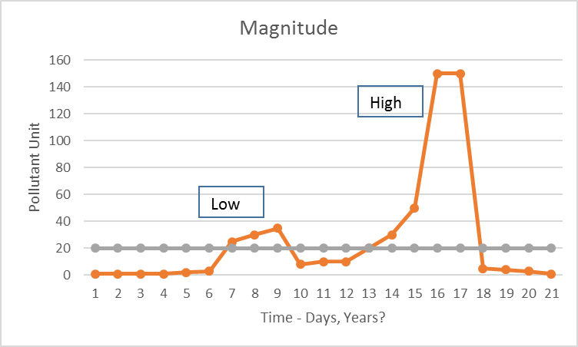
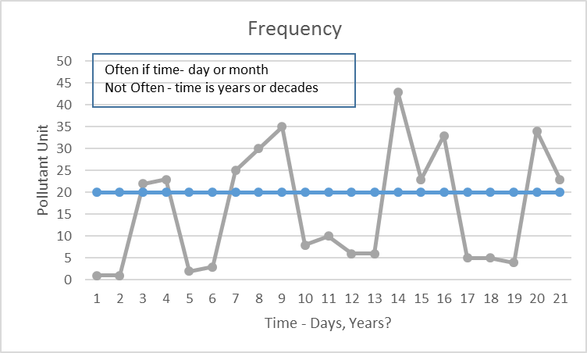
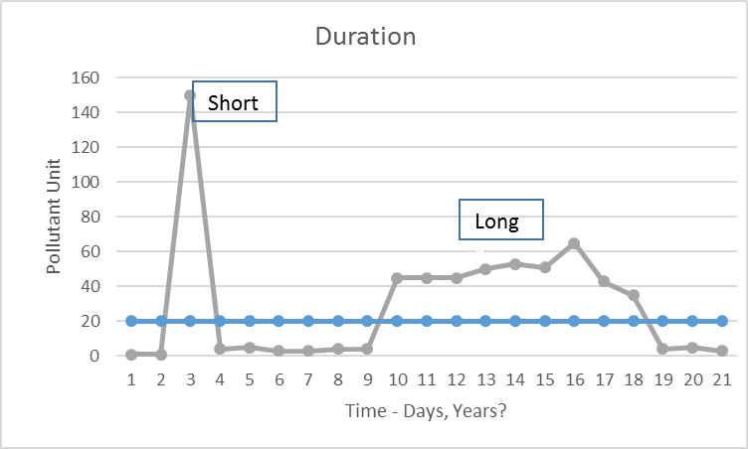
Exposure to metals
Magnitude
Frequency
Duration

Slide 13
Clean Water act
The Colorado Department of Public Health and Environment administers the Colorado Clean Water Act to protect aquatic life from acute and chronic exposure to metals.

Slide 14
Biological Acute
Biological Chronic
Clean water
Act Regulations
Regulatory acute
Regulatory Chronic
High magnitude, relatively short frequency & duration
Sufficient to cause death
Lower magnitude but exceeds threshold, long duration, and high frequency
Causes subtle health issues
No immediate death
The acute standard’s threshold cannot be exceeded more than once in a 3-year period.
The threshold cannot be exceeded more than once in a 3-year period.

Slide 15
Metals Analyzed by River Watch
Aluminum
Arsenic
Calcium
Magnesium
Selenium
Sodium
Potassium
Zinc
Cadmium
Copper
Lead
Iron
Manganese

Slide 16
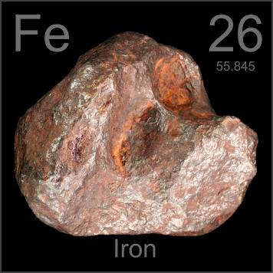
Iron
Necessary to support aquatic life
Often indirectly toxic at lower levels: Iron precipitates on substrate outside of the water column, leaving a yellow stain, hardening substrate, and reducing macro and fish spawning/egg habitat.
Has a relatively short fate and transport, so it does not often reach directly toxic levels (1000+ µg/L)
Source

Slide 17
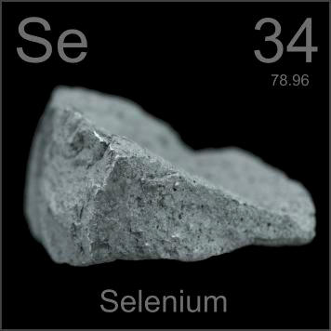
Selenium
Necessary to support life in small amounts
High concentrations cause birth defects, neurological damage, and other impairments in aquatic life and humans.
Two Sources of Selenium in Colorado: Mancos shale and Pierre shale
Irrigation for agriculture can cause selenium to leach into rivers and streams.
High priority pollutant for regulation in Colorado
Toxic at 4-20 µg/L

Slide 18
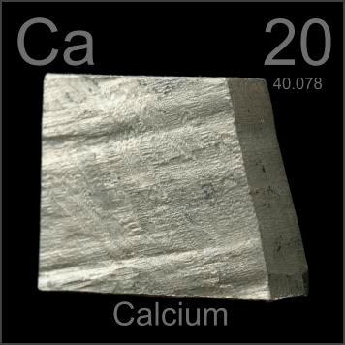
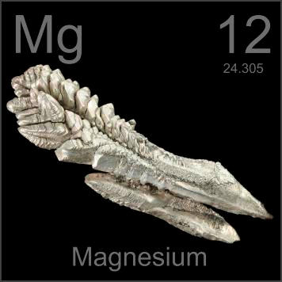
Calcium and Magnesium
Essential and beneficial to aquatic life
Hardness measures the amounts of calcium and magnesium in water.
Geology of the surrounding area determines hardness in streams and rivers
Not toxic to aquatic life
Mitigates the harmful effects of other heavy metals when present in high amounts

Slide 19
Other essential metals
Sodium and Potassium
Manganese
copper
- Essential to life for bone formation, blood clotting, and metabolism
- Never found as a free metal, but found in minerals
- Leaves black stain on rocks outside of the water column
- Essential to life for cellular metabolism and oxygen transport
- Toxic to trout at 20 µg/L
- Tends to stay in water for a long time
- Essential to life
- Behave similarly to calcium and magnesium in water but are less prevalent
- Common in rivers with large groundwater influence or where natural gas is extracted

Slide 20
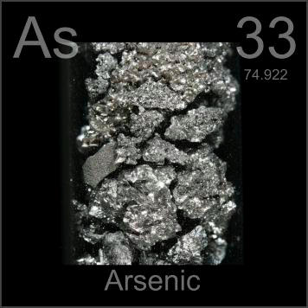
Arsenic
Naturally occurs in freshwater and soil as mineral deposits containing arsenic dissolve
Can bioaccumulate in aquatic life as one organism consumes another, resulting in greater concentrations of arsenic inside animals on the top of the food chain
Other metals, chlorinated organics, and sulfate influence availability and toxicity of arsenic in water
Below 50 µg/L considered safe in drinking water and below 100 µg/L is safe for agricultural use

Slide 21
Cadmium
Lead
Nonessential to life
Toxic to trout at 1.4 µg/L (typically present at background levels of 1 µg/L)
Similar to zinc but less common
Mining and industrial waste produce higher levels of cadmium in water
Nonessential to life
Toxic to aquatic life at 10-100 µg/L
Very toxic to humans
Low solubility in water

Slide 22
Zinc
Aluminum
Essential to life for cell differentiation and growth and the formation of DNA
Toxic to aquatic life at 50-200 µg/L
Becomes more toxic when in the presence of copper
Used to treat drinking water
Leaves white precipitate stain on river substrate
Low levels thought not to be toxic
Acute toxicity at 750 µg/L and chronic above 87 µg/L

Slide 23
