Slide 1
Physical Habitat
River Watch Protocol for Monitoring Physical Habitat

Slide 2
Why Monitor Physical Habitat?
Physical habitat assessment methods aim to identify, survey, and assess physical habitats and the overall functioning and conditions of rivers and streams.
Assessing or evaluating the habitat quality of your sampling area once every year in the fall is critical in determining the ecological integrity of that area and monitoring whether the habitat is changing.
Tips for Physical Habitat Monitoring:
Imagine you’re looking at your sampling area from a bird’s eye view. Think about capturing the big picture.
Remember: Most physical habitat data is subjective and qualitative. Make the best estimations you can, but don’t try too hard to be perfect. These are not direct measurements.

Slide 3
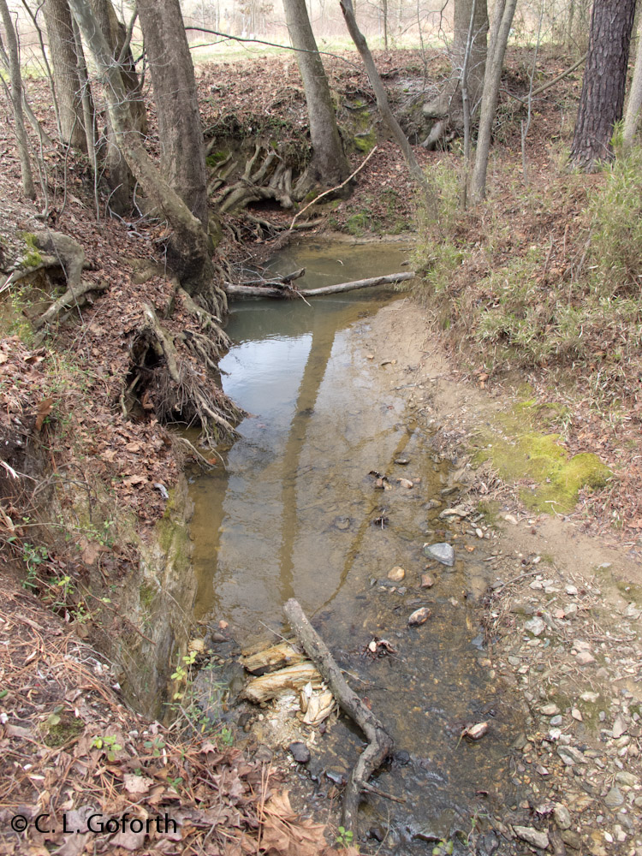
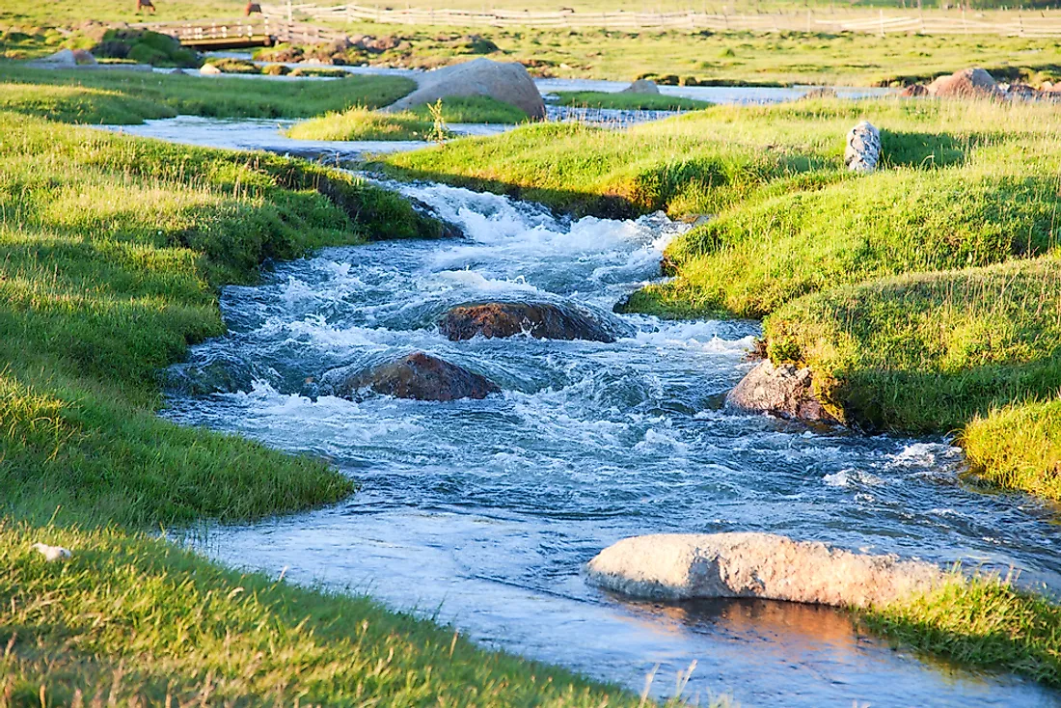
Two Types of Habitat
Macro Habitat
Micro Habitat
A large environment where a lot of different species of plants & animals reside
Examples: the riparian zone, the entire streambed, river banks
A small environment where a few particular species live
Examples: pools of water, riffles, undercut banks

Slide 4
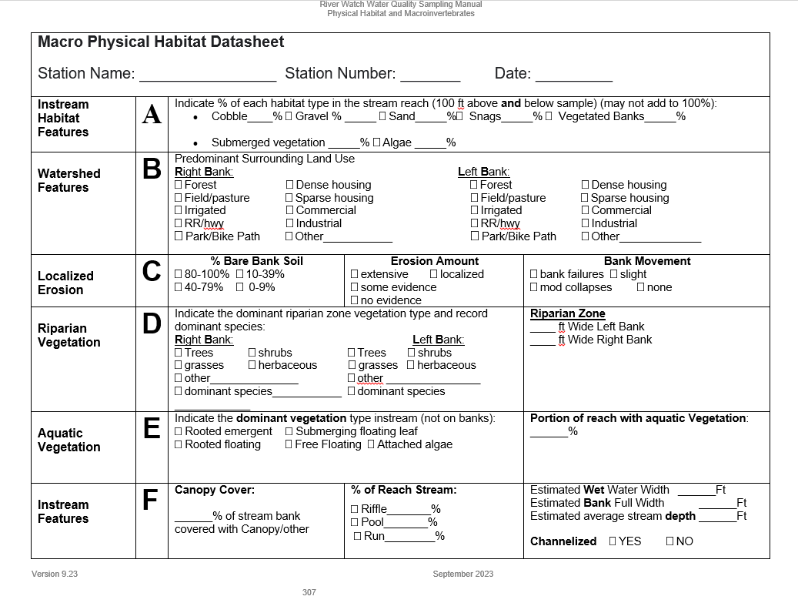
Macro Physical Habitat Datasheet
Use the River Watch Macro Physical Habitat Assessment Datasheet to record your visual assessments.
Assess the entire 200-foot segment surrounding your sample site (100ft upstream & 100ft downstream)

Slide 5
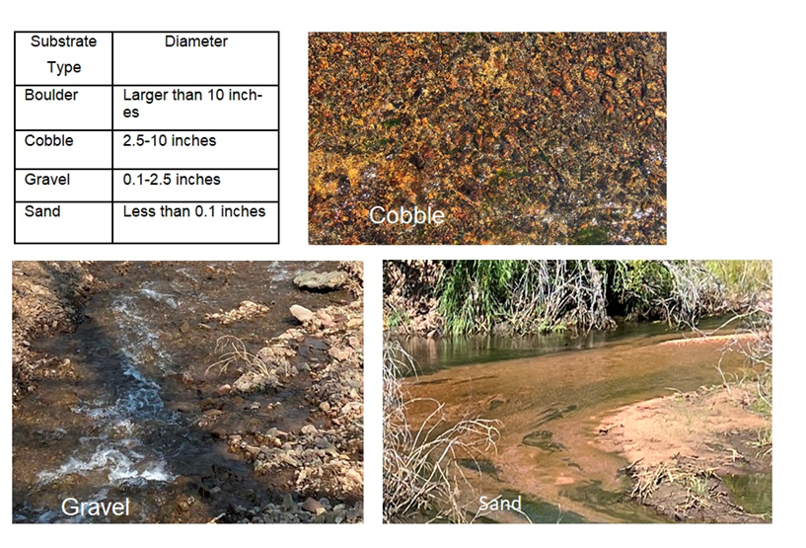
A: Instream Habitat Features
Cobble, gravel, and sand:
Assess the 200ft stretch of streambed for the % cobble, gravel, and/or sand
Macroinvertebrates prefer cobble and gravel because there is more space between the grains for them to inhabit. This is called interstitial space.
Sand does not have as much interstitial space. Therefore, it is typically the least productive macroinvertebrate habitat.

Slide 6
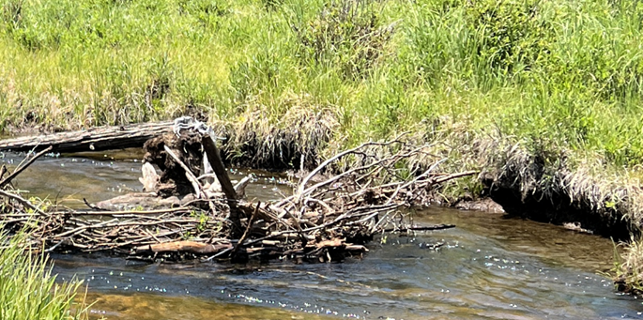
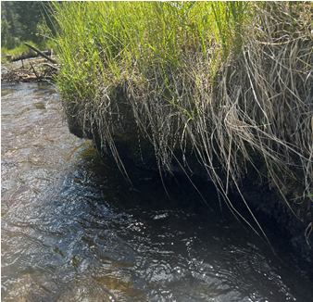
Instream Habitat Features (continued)
Snags: Can include fallen branches, inundated shrubs and trees, and small logs that have been submerged in water for a long time
Provides excellent habitat for macroinvertebrates and fish
Overhanging & vegetated banks: Occur where the river has eroded the soil beneath the roots of streamside plants
Provides good cover and habitat for macros and fish
Vegetation prevents further erosion
Snag
Overhanging & vegetated bank

Slide 7
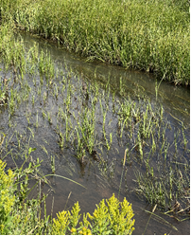
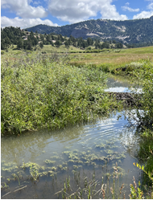
Instream Habitat Features (continued)
Submerged vegetation
Submerged vegetation: Large plants (macrophytes) that live submerged in water. Macrophytes…
Are important primary producers that maintain biological diversity and functional stability of aquatic ecosystems.
Produce oxygen and provide good habitat to some fish and wildlife.
Are seasonal and may not be a common feature in streams, especially in streams with a high gradient.
Algae: Typically attached to rocks and can grow in long strands or float in the stream (see description of “Attached Algae”)

Slide 8
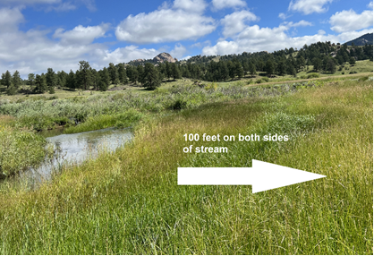
B: Watershed Features
Use these to describe the predominant land uses on each 100ft stretch of land adjacent to the left and right stream banks. Determine the right and left banks by looking upstream from the sampling site.
Forest: evergreen or deciduous trees in a fairly undisturbed tract
Field/Pasture: undisturbed field of grass (can be used for grazing, but it cannot be cropland)
Irrigated: irrigated land used to grow any kind of crop
RR/Hwy: a railroad, highway, or road
Dense housing: a suburban or urban area
Sparse housing: buildings with at least 10 acres of space between them
Commercial: commingled buildings used primarily by businesses, such as a town’s main street (different from dense housing because it is not residential)
Industrial: an area dominated by factories, refineries, etc.
Other: anything that does not fit in the above categories, please describe
Right Bank (looking upstream)

Slide 9
C: Localized Erosion and Sources of Sediment
Local erosion: the process in which materials are worn away and transported by natural forces (e.g. water, especially during flooding events)
Types of Sediment
Suspended sediment: sediment carried by the river in its water column
Bedload sediment: sediment moving along the bottom of the river
The quantity of sediment and the size of the sediment particles in a sediment load are a function of the stream volume (discharge) and its velocity (flow).

Slide 10
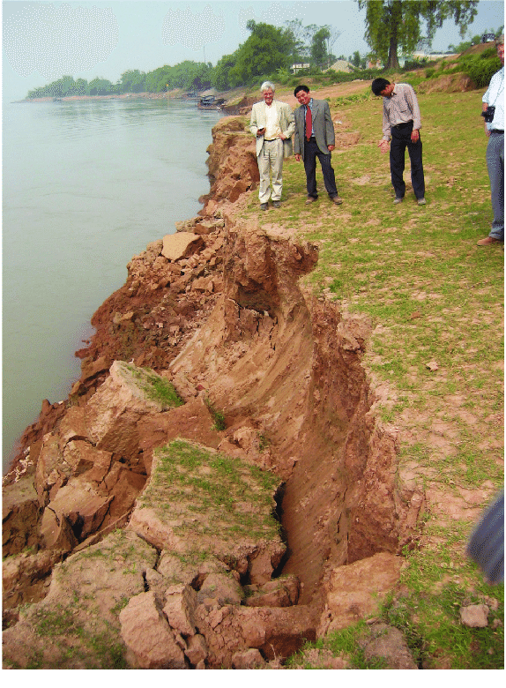
Localized Erosion (continued)
Human activities and natural phenomena that remove vegetation and expose soil make the land vulnerable and can lead to a large quantity of sediment delivered to the river during precipitation driven runoff events
Sources of Sediment
Non-point sources: diffuse, hard-to-identify sources, such as a poorly managed construction site upstream
Point sources: direct and easily identifiable sources, like a pipe
You are evaluating evidence of non-point sources of sediment when assessing localized erosion.
Examples of non-point sources you might see: non-vegetated banks, foot paths, bridges, bare dirt proximate to the banks

Slide 11
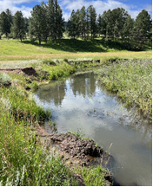
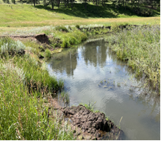
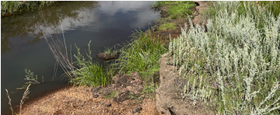
Localized Erosion (continued)
Bare Bank Soil
Make an estimate of the area of bare soil (80-100%, 0-9%, etc.) in the riparian zone that is not bound by plants and their root structures or covered in concrete or rocks.
These bare areas can be caused by wildlife, livestock, humans, roads, or undercut banks.
Erosion Amount
Estimate the amount of erosion that is present on the banks within the reach.
Extensive, some evidence, localized, or no evidence.
Bank Movement
Banks along a river can move or become unstable due to a lack of vegetation or other mechanisms to keep the soil from entering the water.
Assess whether the banks may have become unstable leading to a bank collapse/failure and/or show signs of degradation.

Slide 12
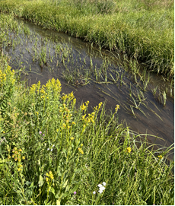
D. Riparian Vegetation
Riparian vegetation provides food, habitat, a migration corridor, soil stability, water quality filtration, shade that cools the river, and/or a buffer for the water body.
Note the dominant vegetation type for each bank:
Trees, grasses, shrubs, herbaceous, or other
The space next to “Other” can be used to explain a lack of vegetation.
Riparian Zone Width
Estimate the width of the riparian zone on each bank.
The width of the riparian zone extends from the water's edge through the riparian vegetation, up to where the vegetation changes from riparian species to more upland prairie or forest type vegetation.

Slide 13
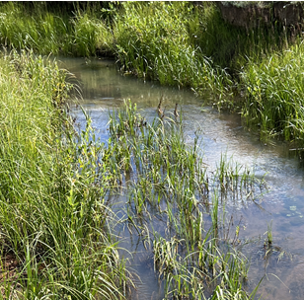
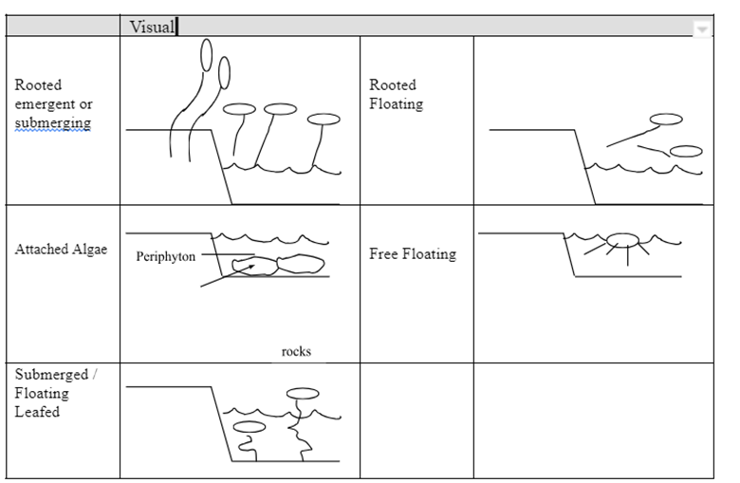
E. Instream Aquatic Vegetation
Aquatic vegetation species need to be submerged in water for some part of their life cycle.
Rooted emergent: an aquatic plant rooted in a wetland, lake, or river substrate
Usually grow at the water’s edge or in shallow water
Most the plant is above the water.
Common examples: rushes, cattails, grasses
Rooted floating: rooted aquatic plant that has come loose and is now floating in the stream
Rooted
emergent

Slide 14
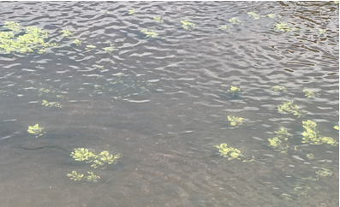
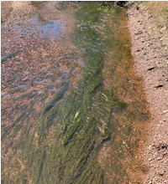
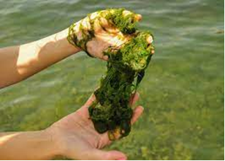
Aquatic Vegetation (continued)
Submerged floating leaf: plants that have root systems attached to the bottom of the water body
Often have leaves and/or flowers that float on the water’s surface
Common examples: water lilies, milfoils, watercress, ribbon weed
Attached algae: grows on any submerged surface and are common in Rocky Mountain streams
Often grow in slower moving water and stagnant eddies
More common in nutrient rich streams with high concentrations of nitrogen and phosphorous
Submerged floating leaf
Attached
algae

Slide 15
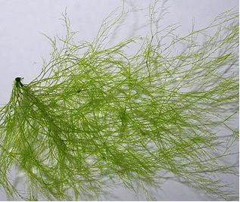
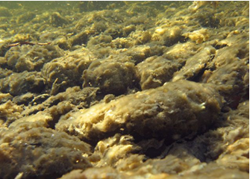
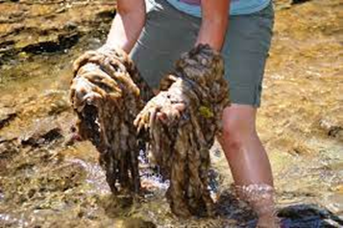
Aquatic Vegetation (continued)
Free floating: a plant that prefers to grow as it floats
Not attached at any time, floating with roots suspended in the water
Occur in relatively still water
Examples: azolla, water hyacinth
Watch out for these invasive algae species:
Rock snot or Didymo
Cladophora
Neither of these species produce algal toxins.
Free floating
Cladophora
Rock snot

Slide 16
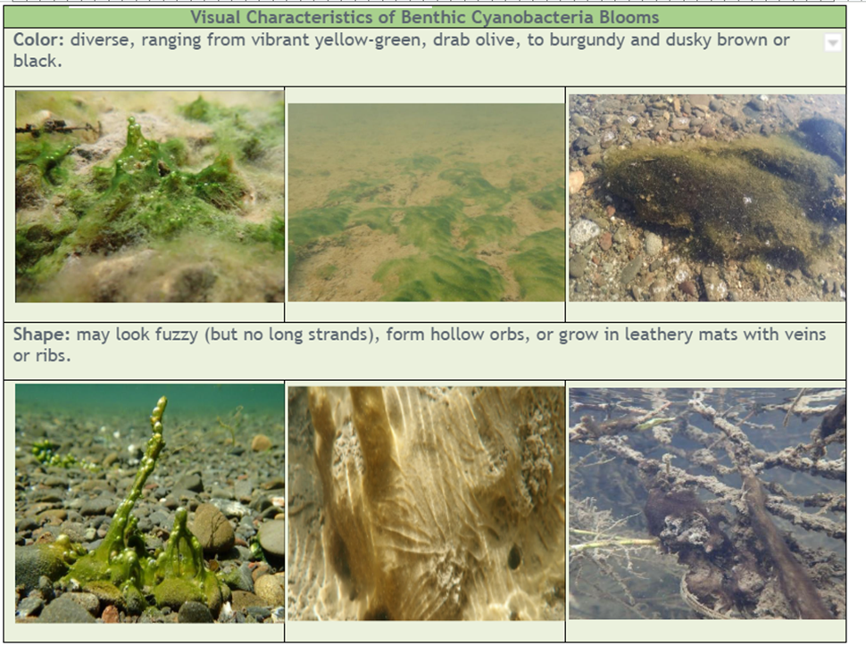
Disclaimer About Toxic Algae in Colorado
More commonly known as “blue green algae”, cyanobacteria are a vital part of aquatic ecosystems.
Cyanobacteria are capable of producing toxins, but they don’t always produce them. Cyanotoxins are harmful to people and wildlife who ingest the water with toxins, and they can irritate skin in contact with the water.
To prevent exposure, do not drink lake or river water, and avoid contact with floating algae mats or suspicious algae blooms.
Follow the instructions on any posted caution or warning signs.
If you suspect a cyanobacteria bloom is present in a waterway, it is best to avoid direct contact with the water. And when in doubt, just STAY OUT!
Contact ToxCall 303-692-2606
cdphe_toxcall@state.co.us
Additional Information/References:
EPA http://www2.epa.gov/nutrientpollution/harmful-algal-blooms
CDC http://www.cdc.gov/nceh/hsb/hab/

Slide 17
F: Instream Features
Canopy cover: Trees and large shrubs provide shade and minimize temperature changes in the stream.
Also provide food and habitat for fish and insects
Estimate the percentage of the stream’s surface shaded by trees and shrubs.
Stream Reach Description: Identify the percentage of each type in your reach
Riffle – fast, shallow water
Pool – slow, deep water
Run – long, deep, slow, gliding pool (typically found in the middle of larger stream)

Slide 18
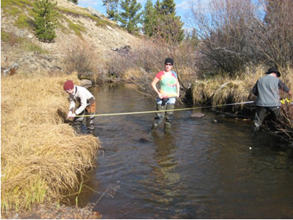
Instream Features (continued)
Wet water width
Width of the water in the stream, from one wet edge to the opposite wet edge
Bank full width
The highest level that water could reach without flowing out of the banks onto adjacent land.
Usually you can tell this by old wet watermarks or vegetation changes

Slide 19
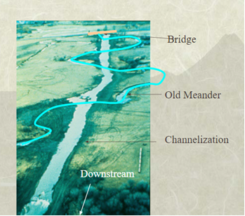
Instream Features: Channelization
Channelization: the artificial process of straightening, widening or deepening stream channels to increase water conveyance and provide anthropogenic services (i.e., flood protection, navigation, drainage to facilitate agriculture and development)
If your stream does not meander, consider the possibility of channelization.
The straightening aspects of channelization often increases erosion.
Removing the bends in the river effectively disconnects the river from the flood plain and the river cannot deposit the sediment it carries.
By removing the natural bends from rivers, the water has a longer time to build up speed and stream power. This also contributes to greater levels of erosion.
Also, channelization can restrict the growth of riparian vegetation.

Slide 20
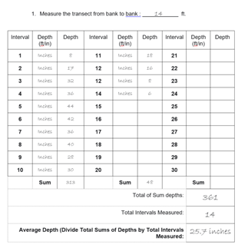
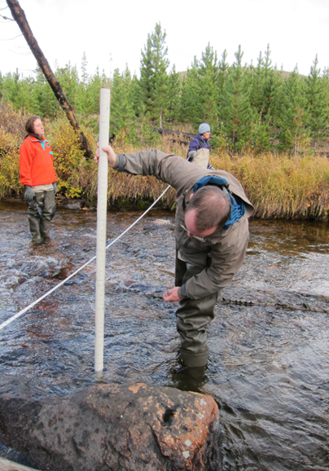
Average Stream Depth Profile
Average Stream Depth: The estimate or measurement of stream depth in several places along a transect in the stream.
Note the intervals (every 6 in., every 1ft, etc.) at which you measure depth along the transect next to or in the “Interval” column.
Record the depths taken at each interval. At the end, add them together and divide them by the number of intervals to find the average depth.
Make sure to indicate which unit of measurement you are using (inches or feet).

