Slide 1
Quality Assurance/ Quality Control (QA/QC)
Module 13 River Watch

Slide 2
Quality Assurance and Quality Control
Definition: QA/QC ensures that River Watch is of a consistent and high quality.
Colorado Department of Public Health and Environment (CDPHE) is the primary user of RW data, so RW follows CDPHE field and lab methods.
The Colorado Water Quality Control Commission also uses this data to implement the Clean Water Act in Colorado.

Slide 3
Standard Operating Procedure (SOPs)
Provide formative evaluation
Provide the appropriate formality and rigor to achieve data quality objectives
Serve as the instructions to implement all tasks, workflows, and processes in the River Watch program
Include the Sample Plan and Quality Assurance Manual

Slide 4
Standard Operating Procedures (SOPs)
Quality Assurance Project Plan
(QAPP or QA/QC Plan)
Standardizes River Watch methods, protocols, and procedures
Takes into account the purpose, data use, and targeted data users from the Study Design and lays out workflow standards that will generate sufficient quality data
Establishes how River Watch is going to produce data of specified quality
Quality Assurance Manual (QAM)
Contains the SOPs (instructions) that the entire lab follows to run tests on River Watch samples
Guides the overall quality of data produced in the CO Parks and Wildlife lab
Identifies a Quality Control Officer that makes sure the SOPs are followed properly
Covers training, how to handle chemicals, analytical machine operation, and other safety guidelines

Slide 5
Purpose of the QA/QC Plan
Guides all staff on how to complete their role in the field, laboratory and data management in a consistent, accurate, precise, reproducible and comparable manner.
Communicates to others the quality of the data, making the data of “known quality.”
Allows any data user to determine if the data can be used for the same purpose and questions, or other purposes with integrity. Ensures data is an asset and can be used multiple times.
Provides a common lexicon and communication to combine data responsibly from multiple sources. Documenting the quality of data collected and being transparent about the quality and methods to achieve that quality is what makes data an asset.

Slide 6
Evaluation of Monitoring Programs
River Watch uses its QA/QC plan to evaluates its water quality monitoring program in two ways:
Formative Evaluation:
Assessing individual workflows or tasks, such as sample collection, processing, or specific analyses
Summative Evaluation:
Assessing the overall monitoring program as a system

Slide 7
Examples of Questions River Watch Asks to Evaluate Itself
Formative:
Were our instructions clear, and did they help volunteers achieve desired results?
Do volunteers understand what is required of them for each water quality test?
If the volunteer fails the unknown pH test at a site visit, what is the problem, and how can we correct it?
Summative:
Is River Watch able to answer our monitoring questions using the data we collect?
Is the data being used effectively to create change and to impact water quality decisions?
How long are volunteers staying in the River Watch program? Has training been effective?

Slide 8
Essential Elements of the QA/QC Plan
Precision
Ensures analyses can be repeated with similar results each time within an acceptable margin of error. Repetition and consistency are key.
Accuracy
Refers to how close a measurement is to the true value. Once a method (e.g. testing pH with a pH meter) provides acceptable results, it can be tested routinely with a known sample for its accuracy.
Reproducibility and Comparability
Reproducibility is concerned with the ability of a data result to be consistently reproduced or be reliable time after time. Comparability focuses on the ability of a result to be compared with other data or criteria.

Slide 9
Strategies to Produce Data of Sufficient Quality
RW volunteers make choices that align with the best method that produces the Study Design’s desired data quality.
Sufficient checks and balances must be in place to discover errors, sample contamination, and data that doesn’t meet desired quality. The checks can remove or qualify this data.

Slide 10
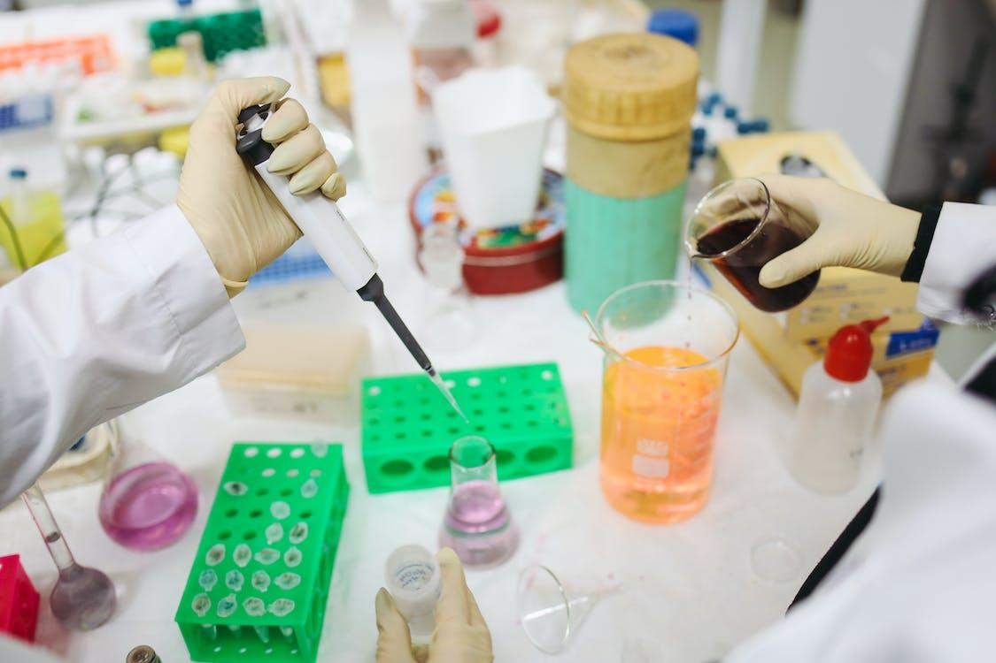
Data Errors
Errors can occur
In the field
In the lab
During sample processing and transportation
While recording and managing data
Not having checks, evaluation, and/or quality standards results in “bad” data, which means the data is of an unidentified/unknown quality.

Slide 11
The River Watch program approaches quality assurance and quality control holistically, incorporating QA/QC components into our training, equipment, documentation, activities, and evaluation

Slide 12
Quality Assurance
How River Watch Implements Quality Assurance
Volunteer Management and Training
Site Determination
Sampling Procedures
River Watch volunteers are required to attend a training workshop where they are trained to operate their RW water quality sampling equipment. Training includes sample preparation, collection, analysis, shipping, recording, and QA/QC procedures.
During the training workshop and annually thereafter, each volunteer group signs a Memorandum of Understanding (MOU) that includes where and when sampling will occur. A data gap and needs assessment is conducted by CPW annually to prioritize sample sites.
Sampling procedures, labeling, containers, and preservation follow Standard Methods and/or EPA guidelines. Volunteers must use provided sample containers, chemicals, equipment, and DI water in addition to following the QA/QC plan’s instructions on testing and shipping.

Slide 13
Quality Assurance
Volunteer Responsibilities
Sample Reporting Limits
Data Management
The volunteers address quality assurance by designating a Quality Control Officer that is responsible for sample quality and record keeping. Volunteers also must complete a Chain of Custody for each shipment of samples that documents these samples and is checked by River Watch staff.
River Watch data is compared against the Sample Parameter Criteria Matrix, which outlines approved methods and reporting limits for each water quality parameter (e.g. metals, pH, D.O.). River Watch has been producing sufficient water quality data for multiple Colorado Clean Water Act decision processes for over 30 years.
River Watch uses standardized datasheets to record data. RW has a robust data application that employs the data schema from the National Water Quality Portal. Numerous validation steps occur to validate the data against field and lab QA/QC samples and checks. The validated RW database is managed by CO Parks and Wildlife. All data is validated by CPW staff prior to public release.

Slide 14
Quality Control
How River Watch Implements Quality Control
In the Field: QA/QC Samples
Unknown Standards
Laboratory
Volunteers collect field duplicates and blank metal samples (both filtered and non-filtered) every fifth sampling event. There must be no metals/ions in the blank samples, and the duplicates’ results should be nearly identical. Industry standard is 10% of all samples collected are QA/QC samples. River Watch asks for 20%.
Unknown standards for pH, alkalinity, and hardness are prepared for participants to analyze in order to check their procedural accuracy as well as chemical accuracy twice a year. Staff knows the value of the “unknown” solution, but the value is unknown to volunteers. A duplicate test between each group’s equipment and River Watch’s equipment is also performed at site visits.
The River Watch laboratory is located at the CPW Fort Collins office. Over 60 River Watch SOPs dictate workflows in the laboratory. Examples of QC in the lab:
Method blanks
Calibration standards
Check standards
Control samples
Matrix spikes
Duplicate analysis

Slide 15
Quality Control
Quarterly Recalibration’s Using
CDPHE Methods
Annual Independent Laboratory Splits
QA/QC Reports
River Watch Laboratory will recalibrate machine lower method detection limits (MDL) and lower reporting limits (LRL) each quarter. Changes are input into analyses machines and the River Watch database. Specific data exports display the MDL and LRL for each indicator.
River Watch will split one filtered metal sample and one nutrient sample of a relatively high concentration with an independent lab and report those results. When results are comparable, this provides credibility for the program, and if not, RW addresses the differences and makes corrections to reach a sufficient quality.
The volunteer annual performance report, which is reviewed at each site visit
Access to the stations’ metal blank and duplicate data
Unknown data report for individual organizations
Annual report of unknown data (combination of all groups’ unknown data)

Slide 16
Volunteers’ QA/QC Responsibilities
Volunteers are the first point of QA/QC with their eyes and ears on the ground, checking results to see if they make sense with what they know, previous results, and local events.
Properly use, care for, and maintain chemicals and equipment
Collect samples at frequency and location according to the RW MOU
Collect blank and duplicate samples
Complete unknown tests at site visits
Record data accurately on data sheets
Keep organized file of your RW records, including hard copies of your data
Ship all samples within prescribed holding times

Slide 17
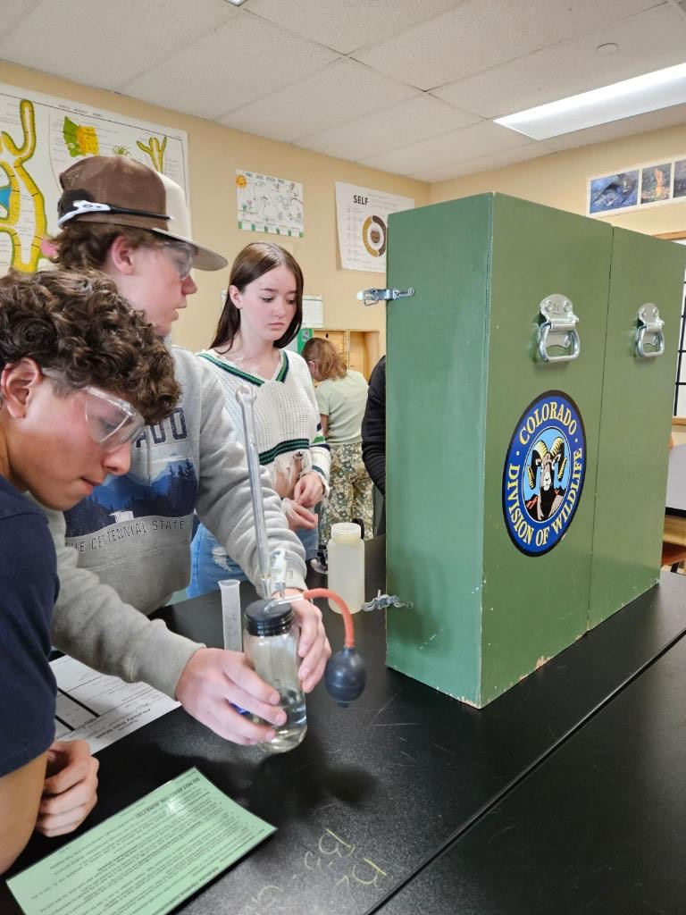
Site Visits
River Watch staff visits each volunteer group at their site once per year.
Primary Purpose: to test the equipment, chemicals, and training of volunteers, as well as their skills at performing the alkalinity, hardness, DO, and pH tests
Secondary Purpose: to update as necessary sample collection and analyses methods in person
Successful site visits certifies the group’s data for the year.
Staff will also answer questions, replenish supplies, pick up samples, and connect with volunteers.

