Slide 1
River Continuum
Module 14 River Watch

Slide 2
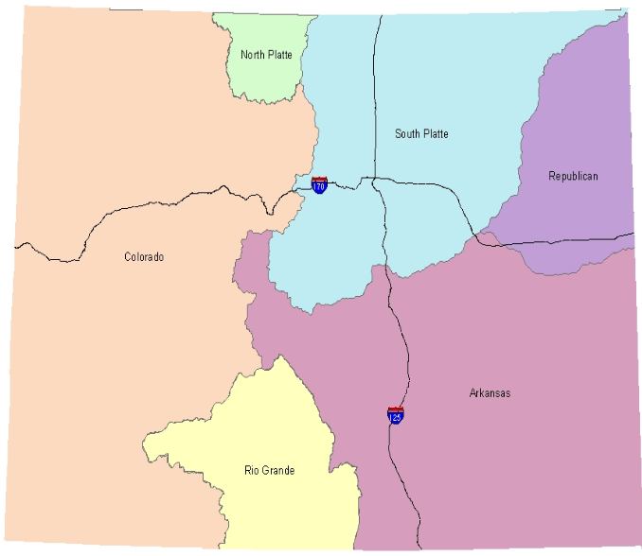
Watershed
Map of Colorado Watersheds
Definition: the land area from which a stream, lake, or other body of water receives its water.
A watershed is delineated by high points in the landscape (mountains, hills, and ridges) from which all water flows downhill to a low point, such as a river, stream, pond, lake, or wetland.

Slide 3
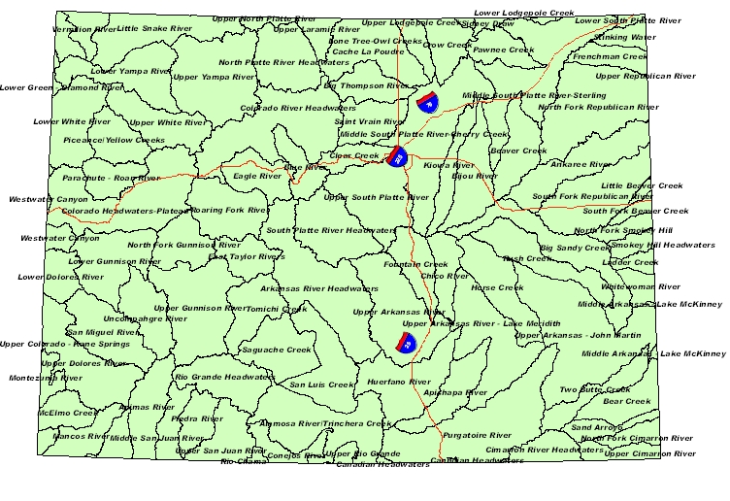
Watersheds in Colorado
Colorado is unique in that it is only one of two states (the other is Hawaii) where water flows out of the state but almost no water flows into the state.
Colorado is a true headwater state.
The water that leaves the state directly and/or indirectly affect 31 other states.
CO has six major watersheds.
Water and land uses that affect water quantity and quality in watersheds: urbanization, floods, deforestation, fires, agriculture, and mining

Slide 4
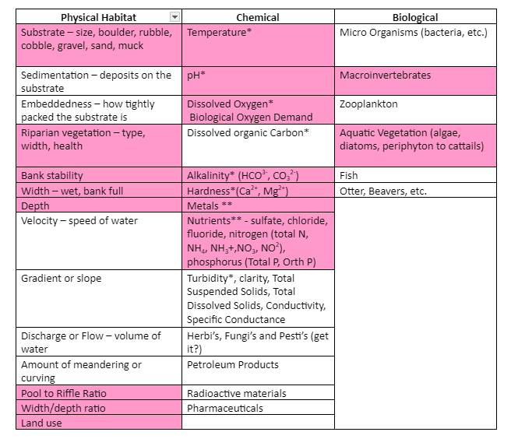
Physical, Chemical, & Biological Stream Attributes
River Watch’s primary data objective is to collect long term baseline aquatic ecosystem data.
Physical, chemical, and biological attributes characterize the ecosystems in streams & rivers.
These parameters help gauge the stream’s health and water quality.

Slide 5
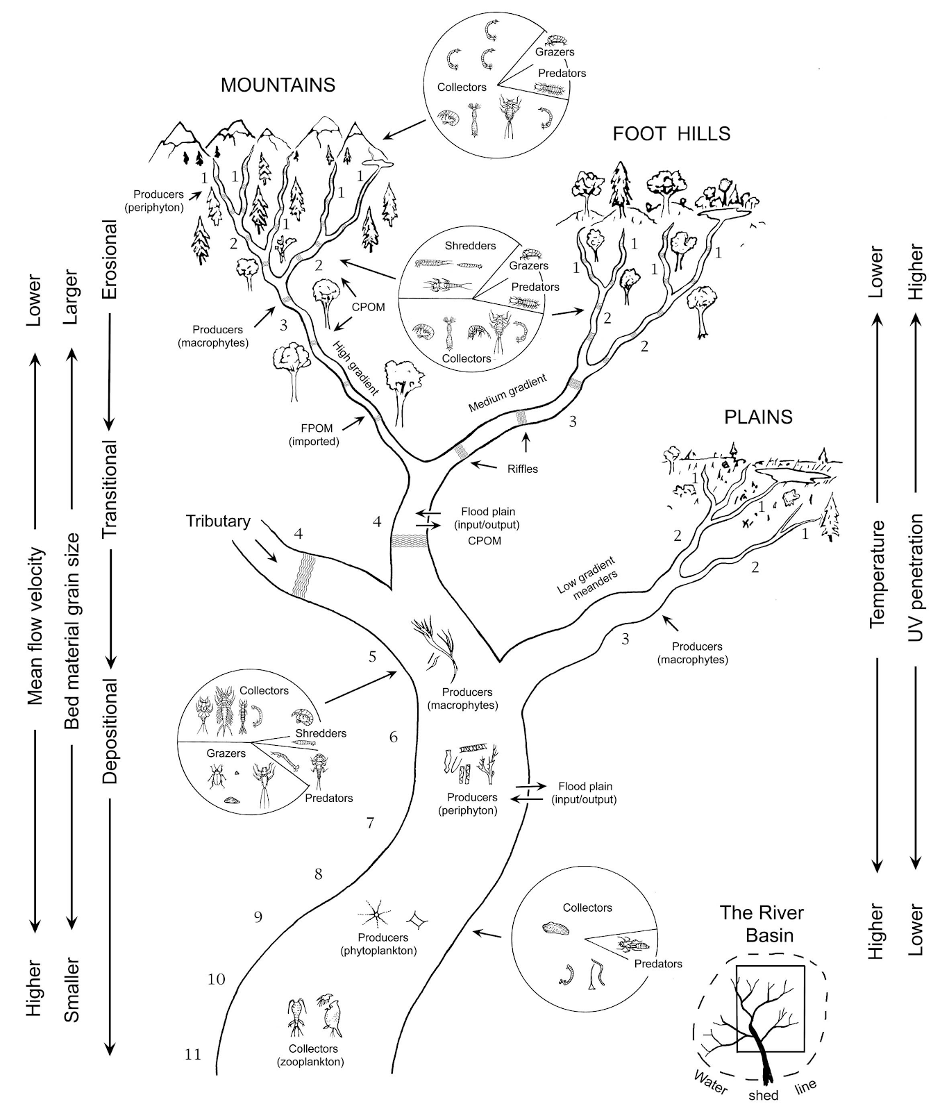
Stream Order
Categorizing Streams by Size:
Rule 1: The stream increases in size only when like numbers join. (1 + 1 = 2)
Rule 2: The increase in size is only by one increment (2 + 2 = 3).
Rule 3: When unlike numbers join, the stream remains the higher number. (1 + 2 = 2)
Distribution of Stream Size in the World:
Small Sizes 1-3 88%
Medium Sizes 4-6 10%
Large Sizes 7-12 2%

Slide 6
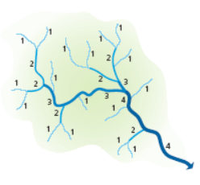
River Continuum
Definition: the concept that a river is a predictable physical, chemical, and biological continuum of attributes
The river continuum refers to the common patterns of change in these attributes that occur as water moves upstream to downstream.

Slide 7
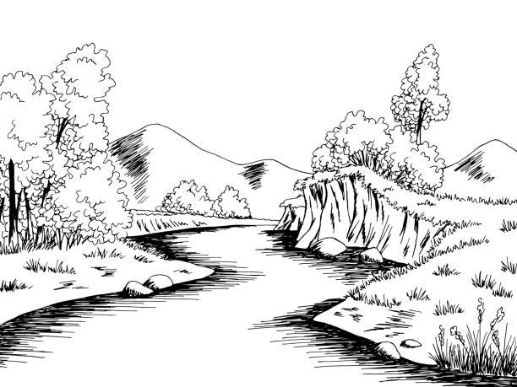
River Continuum: Upstream to Downstream Trends
Increases Downstream:
Most chemical parameters (alkalinity and hardness)
Temperature
Turbidity
Pool/riffle ratio
Width and depth
Pools
Sinuosity
Remains neutral/depends on other factors:
pH
Bank stability
Sedimentation
Riparian vegetation type
Decreases Downstream:
Dissolved oxygen
Stream substrate size
Canopy shade
Riffles

Slide 8
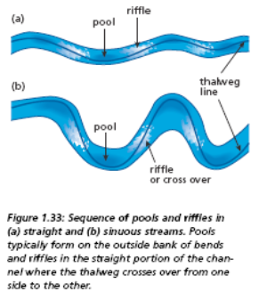
Pools and Riffles
Pool/Riffle Ratio
Pools - deep areas in the river where water gathers and slows down
Riffles - shallow, fast-moving areas in the river that produce “riffles” or small waves on the water’s surface
Thalweg – a line drawn by connecting all of the lowest points in a river
Larger river = larger pool/riffle ratio (greater than one)
More riffles are often found in smaller streams and/or streams with coarser substrate (e.g. gravel or cobble).

Slide 9
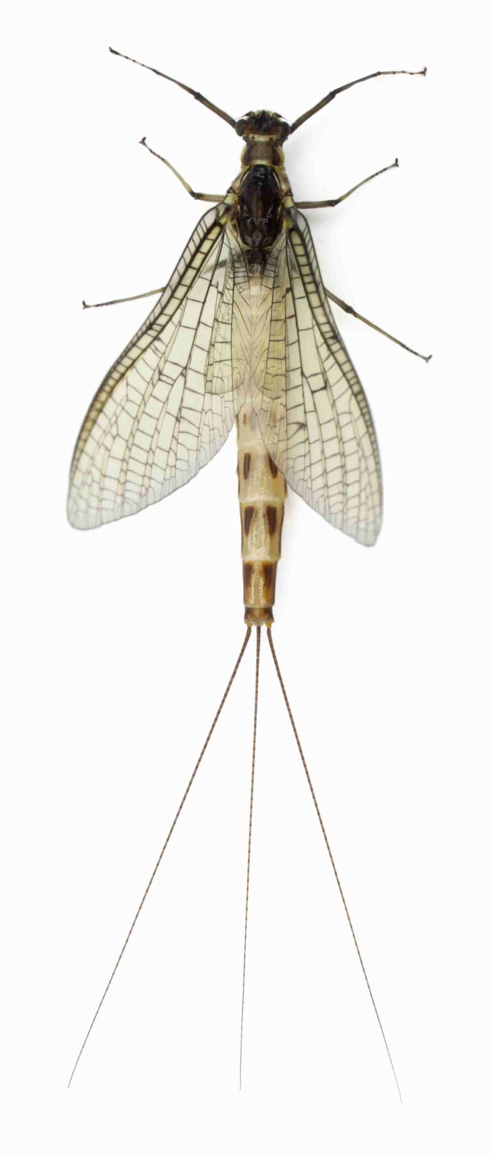
River Continuum: Biological Attributes
Three indicator species of cold, clear water: mayflies, stoneflies, and caddisflies
These three species tend to disappear in much larger rivers because the chemical and physical attributes no longer support them.
They are not very pollution-tolerant, so their presence/absence indicates river health.
Black flies dominate larger rivers with slower, warmer water than small streams.

Slide 10
Macroinvertebrates’ Feeding Niches
Predators – consume prey/other animals
Grazers – graze periphyton growing on rocks
Collectors – build nets to collect food
Shredders – break down larger foods to consume them

Slide 11
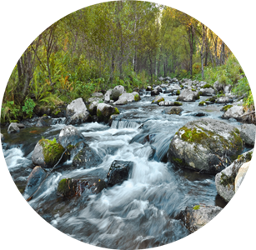
River Continuum: Food & Feeding Niches
Small Streams
Main Food & Energy Source: Coarse Particulate Organic Matter (CPOM) (e.g. small twigs and leaves)
Macros: many shredders and grazers
Heterotrophic – small streams get their primary nutrients from outside of themselves
Allochthonous food sources – non-native material from outside the stream
Surrounding landscape has a big impact on stream’s ecosystem.

Slide 12
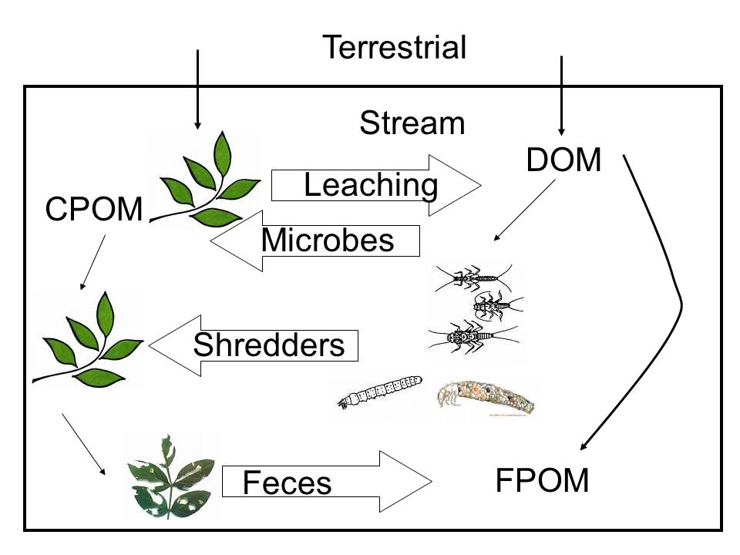
River Continuum: Food & Feeding Niches
Medium Streams
Main Food & Energy Source: Fine Particulate Organic Matter (FPOM) (e.g. small particles of plant matter)
Macros: Many grazers and collectors, less shredders
Autotrophic – has enough primary productivity to support itself
Autochthonous food sources – native material produced by bacteria, algae, and decomposition
These streams are more independent of the surrounding watershed, though this support is still essential.

Slide 13
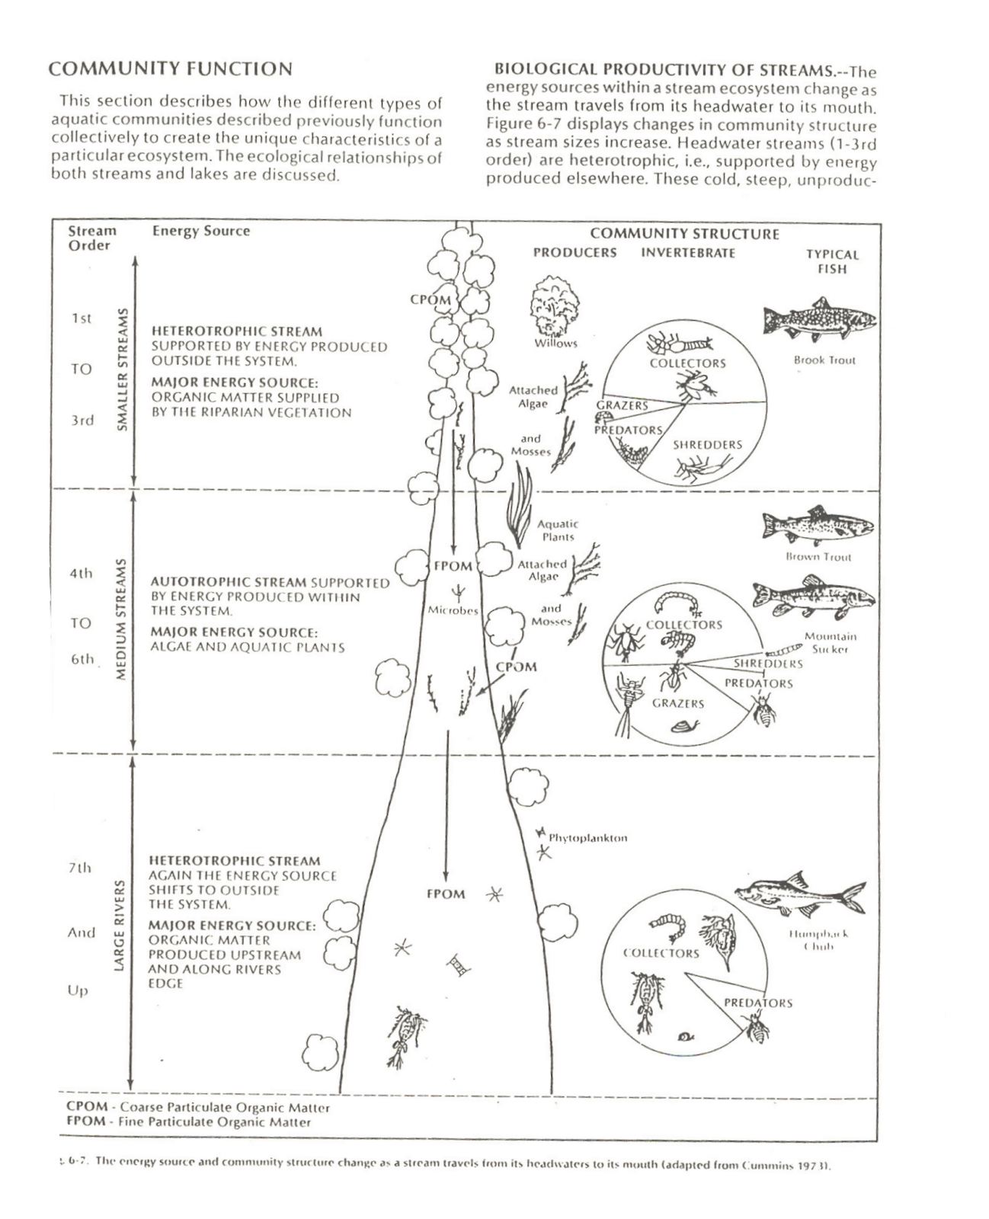
River Continuum: Food & Feeding Niches
Large Rivers
Large rivers become heterotrophic systems again because they are too wide and deep to support themselves with primary productivity.
The river is anaerobic (has no oxygen) deep below the surface, so its fish and macros must rely on food flowing into the river from other tributaries.
Macros: collectors and predators

Slide 14
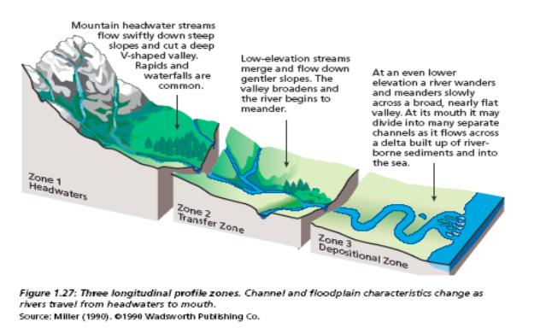
Longitudinal River View
Most streams can be divided into three zones:
Headwaters
Transfer Zone
Depositional Zone

Slide 15
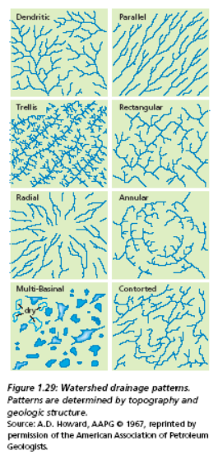
Drainage Patterns
Topography and the geologic structure of an area determine how water drains in a particular watershed.

Slide 16
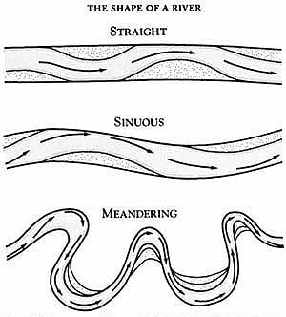
Sinuosity
Definition: the amount of curvature in a stream or river
It is a function of gradient (slope of a stream measured by the ratio of decreases in elevation and distance) and discharge (volume of water)
Natural river channels meander and bend, and typically, they do not travel straight through a landscape.
Wider, flatter landscape = more sinuous
Channelization: the process of straightening the river’s path for human purposes

Slide 17
Streamside Vegetation
Headwaters: forest, grasses, shrubs, short plants
Transfer Zone: native grasslands, farmland, diverse floodplain
Depositional Zone: wetlands, hardwood tree, emergent marsh vegetation, rooted floating plants, free-floating plants

Slide 18
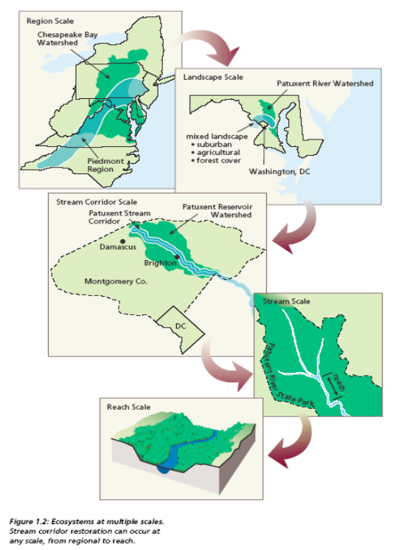
Spatial Scale for Streams and Watersheds
1. Regional Scale:
A broad geographical area with a common macroclimate and sphere of human activities and interests
2. Landscape Scale:
A geographic area distinguished by a repeated pattern of components, which include natural communities like forests and wetlands and human-altered areas like croplands and villages

Slide 19
Spatial Scale for Streams and Watersheds
3. Stream Corridor Scale:
A spatial element (a corridor) at the watershed and landscape scale that includes two important elements—the stream channel and the plant community on either side of the stream
4. Reach Scale:
A section of a stream or river that is defined by having common flow, biological or chemical factors, tributary confluences, or by some human influence that makes one part of the stream different from the next

Slide 20
Streamflow
Baseflow - precipitation that percolates to the ground water and moves slowly through substrate before reaching the channel. It sustains streamflow during periods of little or no precipitation.
Stormflow - precipitation that reaches the channel over a short time frame through overland and underground routes
Floodplain - a highly variable area on one or both sides of the stream channel that is inundated by floodwaters at some interval, from frequent to rare. The floodplain provides temporary storage space for floodwaters and sediment produced by the watershed.
Discharge - the volume of water moving down the channel per unit time. The basic unit of measurement used in the United States to describe discharge is cubic foot per second (cfs).

Slide 21
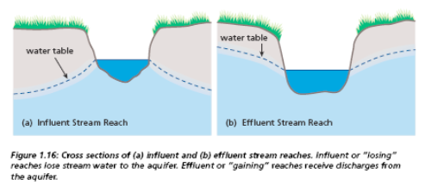
Streams’ Interaction with Groundwater
Influent or “losing” reaches lose stream water to an aquifer.
Effluent or “gaining” reaches receive discharges from an aquifer.

Slide 22
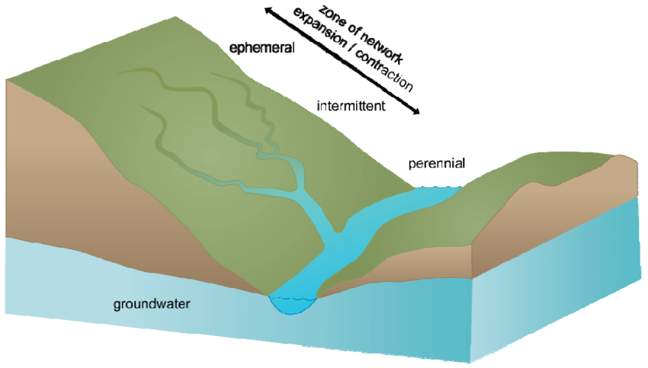
Infographic Source

